Slide 1
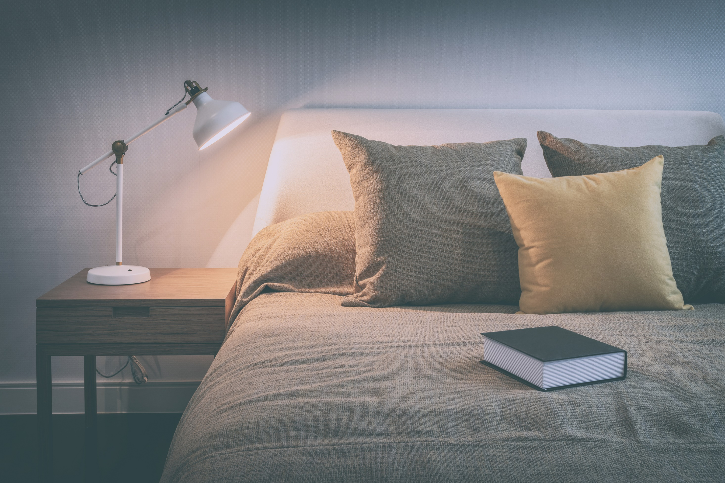

Melatonin: How Much Do We Really Know?
SLEEPEDUCATION.ORG
Notes:
Alternate titles:
Melatonin in Clinical Use: Science, Safety, and Skepticism
Melatonin Under the Microscope: Efficacy, Limits, and Risks

Slide 2
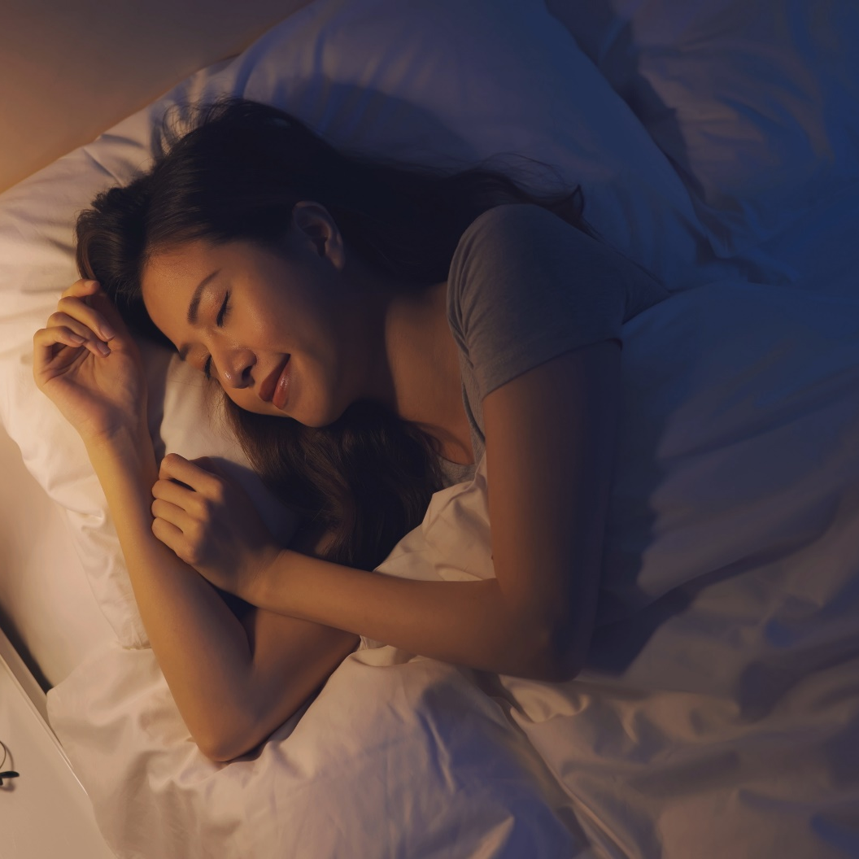
What is Melatonin?
A neurohormone that is produced by the pineal gland, a small gland in the brain
Naturally secreted in response to darkness, inhibited by light.
Regulates circadian alignment and the sleep-wake cycle.
Available over-the-counter in pills, gummies, or liquids formulations
SLEEPEDUCATION.ORG
Notes:
Dubbed the “sleep hormone,” melatonin functions as both a turn-down service and an internal alarm clock. When your melatonin levels increase, you start to feel tired and more chilled out. Decreasing melatonin levels are a signal that it’s time to rise and shine. Melatonin helps your body know when it’s time to sleep and wake up. Within the pineal gland, melatonin production fluctuates depending on the time of day.
Exogenous melatonin refers to melatonin that is not naturally produced by the body but taken as a supplement.
Exogenous melatonin can improve sleep efficiency when endogenous melatonin is absent (e.g., during the circadian day) but has limited effect when endogenous melatonin is already present (e.g., during the circadian night). BASICALLY it helps the body know when it’s time to sleep and wake up.

Slide 3
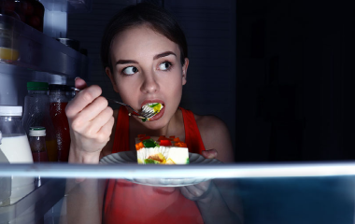
Dietary factors and fluctuating levels of melatonin
Intake of vegetables, caffeine, and some vitamins and minerals, can modify melatonin production.
Melatonin has been detected in notable amounts in tomatoes, olives, grapes, barley, rice, walnuts, wine and beer.
Energy restriction reduces the nocturnal secretion of melatonin (up to 20%)
SLEEPEDUCATION.ORG
Notes:
The regulating system for the secretion of melatonin is complex. Melatonin synthesis is controlled by both an endogenous circadian clock and by environmental light. Light is the dominant and influential environmental factor that controls its synthesis. In an ideal world, melatonin levels would sync up with the presence of natural light.
In addition, melatonin synthesis depends upon availability of its precursor, tryptophan (TRP), which is an essential amino acid and is thus an essential component of the diet. If intake of TRP is severely restricted, synthesis of melatonin is significantly reduced. In general, diets rich in vegetables, fruits and grain products contain considerable levels of dietary melatonin.
Short-term voluntary fasting by total rejection of food or with very limited intake of energy (<300 kcal per day) from 2 to 7 days reduces melatonin concentration in the blood by about 20%
However, melatonin levels can decrease due to factors such as stress, smoking and shift work that disrupt your sleep patterns.
If you are in the habit of scrolling through your phone or tablet at night, the glow produced by your screen can also cause melatonin to drop. A lack of exposure to natural light during the day is also associated with lower melatonin levels.

Slide 4
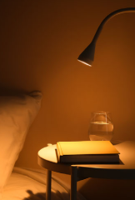
Does exogenous melatonin taken as a dietary supplement enhance sleep?
SLEEPEDUCATION.ORG

Slide 5
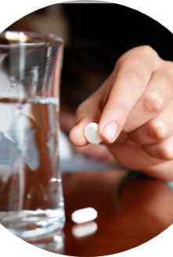
Melatonin for Adults: Potential uses
Circadian Rhythm Sleep-Wake Disorders:
  Jet lag disorder
  Shift work disorder
  Delayed Sleep-Wake Phase Disorder
  Non-24-hour Sleep-Wake Rhythm Disorder in visually impaired adults
REM Sleep Behavior Disorder
AASM DOES NOT Recommend for:
Chronic Insomnia in Adults: The AASM strongly recommends Cognitive Behavioral Therapy for Insomnia (CBT-I) as the first-line treatment for chronic insomnia in both adults and children. Melatonin should generally not be used for this purpose.
SLEEPEDUCATION.ORG
Notes:
Jet Lag: To help reset the body clock when traveling across time zones.
Shift Work Sleep Disorder: To adjust sleep patterns for those working irregular hours.
Delayed Sleep-Wake Phase Disorder: When the body's natural sleep time is significantly later than desired.
Non-24-hour sleep-wake disorder is a circadian rhythm sleep disorder in which an individual’s biological clock fails to synchronize to a 24-hour day. They have a circadian rhythm that is shorter or, more often, slightly longer than 24 hours. This causes sleep and wake times to get pushed progressively earlier or later, usually by one or two hours at a time. Over days or weeks, the circadian rhythm becomes desynchronized from regular daylight hours. Non-24-hour sleep-wake disorder is most common in people with total blindness, due to the lack of light input reaching the internal clock. It’s estimated that approximately 50% of completely blind people have N24SWD. Not all blind people suffer from this disorder, because some retain the ability to perceive light to a certain extent.
REM sleep behavior disorder (RBD) is a sleep disorder in which you physically act out your dreams unknowingly while you’re asleep. The movements involved in RBD can cause injury to you or your bed partner, especially if you’re acting out a violent nightmare. It’s important to seek treatment because of this.

Slide 6

Melatonin for Children: Potential Uses
(Under Medical Guidance)
  Short-term use for specific issues like jet lag.
  In children with certain neuro-developmental conditions (e.g., ADHD, autism) where sleep difficulties are common and well-documented.
SLEEPEDUCATION.ORG
Notes:
There is good scientific evidence that melatonin can shorten the time to fall asleep in children with insomnia, including children with ADHD, autism, and other neurodevelopmental disorders.
While melatonin can be an effective short-term solution to address bedtime problems, children with neurodevelopmental disorders may benefit from longer-term use in some cases.
Ideally-it should never be a “stand alone” solution and should always be accompanied by behavioral interventions.

Slide 7

AASM’s Health Advisory Melatonin Use in Children and Adolescents
  Keep Out of Reach of Children
  Consult a Healthcare Professional FIRST
  Prioritize Healthy Sleep Habits
  Choose "USP Verified" Products (if using)
SLEEPEDUCATION.ORG
Notes:
The American Academy of Sleep Medicine (AASM) develops health advisories to provide guidance for the public on important topics related to sleep health and sleep disorders. Health advisories are hosted on the AASM’s sleep education public website .
To address the safe use of melatonin in children and teens, the AASM advises the following:
Keep Out of Reach of Children: Treat melatonin like any other medication and store it safely away from children.
Consult a Healthcare Professional FIRST:
Before giving melatonin to children: This is especially crucial due to the unregulated nature of supplements and the risk of accidental overdose. Many childhood sleep problems can be addressed with behavioral changes.
For adults with sleep issues: Talk to your doctor to determine the best treatment option, especially if you have chronic insomnia or suspect an underlying sleep disorder.
Dose and Timing Matter: If melatonin is recommended by a healthcare professional, the correct dose and timing can vary depending on the individual and the specific sleep problem. A higher dose is not necessarily more effective.
Prioritize Healthy Sleep Habits: Before considering melatonin, try established healthy sleep practices:
Maintain a consistent sleep schedule (even on weekends).
Create a relaxing bedtime routine.
Make your bedroom quiet, dark, and cool.
Limit screen time before bed.
Avoid large meals before sleep.
Exercise regularly.
Choose "USP Verified" Products (if using): Look for products with the USP Verified Mark, which indicates that the product was produced in a facility following good manufacturing practices and contains the amount of ingredients stated on the label without harmful levels of contaminants. However, this is a voluntary program, and only four melatonin products, all with either 3 mg or 5 mg of melatonin, have received the USP Verified Mark.

Slide 8
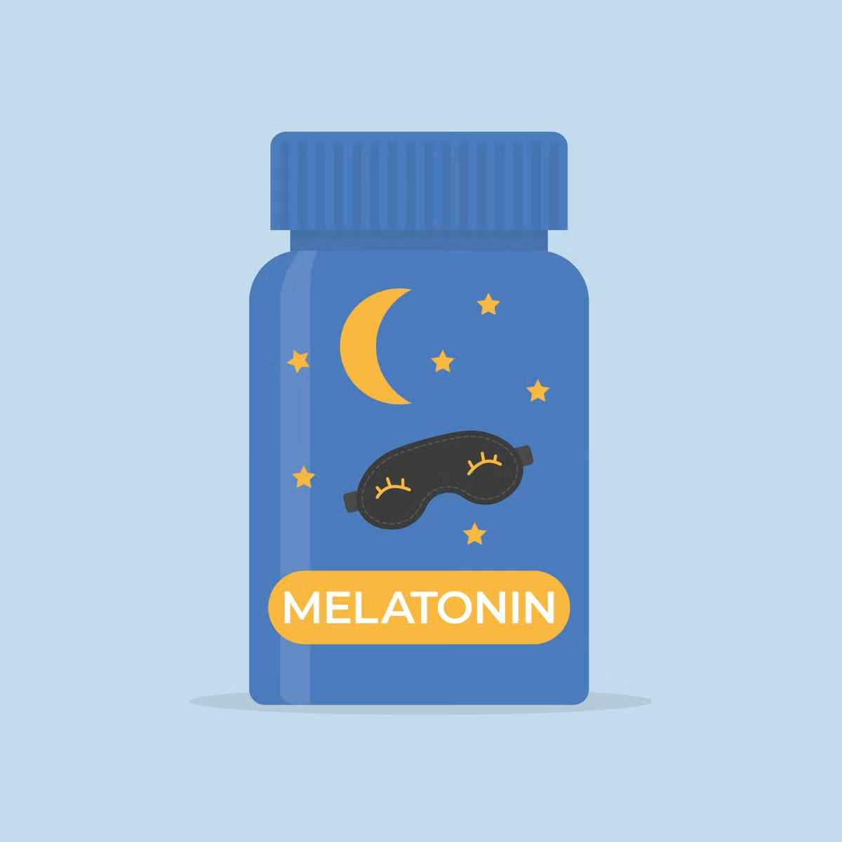
How safe is Melatonin for Kids?
Melatonin should not be used in children without sleep problems just to “help them get better/more restful sleep”
Never substitute for healthy sleep practices
Keep it well away from children for whom it’s not intended
SLEEPEDUCATION.ORG
Notes:
If you surf the web, you’re likely to get mixed messages, with some experts sounding an alarm and others saying it is harmless.
Why are more parents grabbing melatonin? Because of the way it’s marketed…. It’s right there in the supermarket or the drugstore, next to the multivitamins. People don’t realize that taking melatonin is something that should be taken seriously, and for kids, you should run it by the pediatrician first…
In the U.S., melatonin is available over the counter as a dietary supplement. This differs from other countries, such as the United Kingdom, Japan and Australia, where melatonin is regulated as a prescription medication.
It’s important to realize that it’s not an FDA-approved drug since it’s a dietary supplement. So, it’s not as strictly regulated as a prescription medication. Supplements are not evaluated by the FDA for safety and effectiveness; companies don’t have to submit proof that their supplements work or that the ingredients listed are accurate.
Not all melatonin is alike
What you see may not be what you get when it comes to melatonin. A recent study measured the actual amount of melatonin in 31 different brands and found a huge amount of variation from the melatonin content listed on the label, both significantly less than and greater than the claimed amount. This variability was found across brands and even from one lot to another within a given brand. Some products also have other components added. For these reasons, we strongly recommend use of “pharmaceutical grade melatonin” to produce reliable and consistent effects (this can be found online).
In gummy form, melatonin supplements can be enticing for children, leading to a risk of overconsumption. Taking a large dose of melatonin can cause gastrointestinal issues or irritability. A large dose also can keep your child's body from naturally producing melatonin to make them sleepy. A recent study from the Centers for Disease Control and Prevention (CDC) raises some concerns. It found an alarming six-fold increase in the past decade in the number of children and teens reported to poison control centers for melatonin ingestion.
Always : check the label You should also be aware that many non-sleep products may contain melatonin as a secondary ingredient. Two examples are children’s “nighttime cough syrup” and “relaxation” drinks.

Slide 9

AASM Sleep Prioritization Survey
Melatonin and Kids
Question to parent: Have you ever given melatonin to your child (under the age of 18) to help him or her fall asleep at night?
YEAR | Teens under 13 | Teens over 13
2025 | 24%
2024 | 45%
2023 | 46% | 30%
SLEEPEDUCATION.ORG
Notes:
Each year since 2019, the AASM has commissioned an online survey by an independent market research agency. The survey of adults in the U.S. asks about a variety of sleep-related topics. (Newsroom | Press Room | Media Relations | AASM)
In all 3 years, I was noted that the Millennial Parents are most likely to say they have given a child under the age of 18 melatonin to help him or her sleep.

Slide 10
Trivia question
In the U.S., melatonin is classified as which of the following?
A) Prescription drug
B) Controlled substance
C) Dietary supplement
D) Hormone therapy
SLEEPEDUCATION.ORG

Slide 11
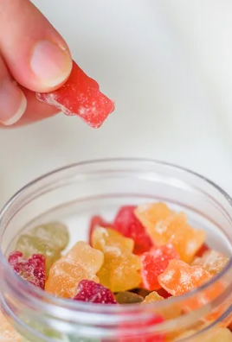
Melatonin: A
Dietary supplement
A dietary supplement is “ a product taken by mouth that contains a 'dietary ingredient' intended to supplement the diet.“
Pros:
  Easy to access
  Widely available
Important Caveats:
  Less Regulation Than Drugs
  Labeling May Be Inaccurate
  No Guarantee of Purity or Potency
SLEEPEDUCATION.ORG
Notes:
According to the U.S. Food and Drug Administration (FDA), a dietary supplement is:“ A product taken by mouth that contains a 'dietary ingredient' intended to supplement the diet.“
Pros:
Easy to access: Sold over-the-counter (OTC) without a prescription.
Widely available: Found in pharmacies, grocery stores, and online.

Slide 12

Efficacy, Limits, and Risks
Less Regulation Than Drugs
Inconsistent Dosing
Potential for Other Ingredients
Limited Long-Term Safety Data
SLEEPEDUCATION.ORG
Notes:
Less Regulation Than Drugs
The FDA does not review or approve dietary supplements for safety or effectiveness before they are sold. Melatonin is accessible and legal to use without a prescription, but it’s not held to the same rigorous standards as pharmaceutical drugs.
Inconsistent Dosing: The manufacturer is responsible for making sure the product is safe and accurately labeled. Studies have shown wide variability in the actual melatonin content of supplements, sometimes ranging from less than half to more than four times the amount stated on the label. This is especially true for chewable forms, which children are more likely to use.
Potential for Other Ingredients: Some products may even contain other chemicals that require medical prescriptions.
Limited Long-Term Safety Data: While generally well-tolerated in the short term, there are very few long-term safety studies on melatonin use. Unlike prescription drugs, there's no strict requirement for consistency between batches unless the product is third-party tested (e.g., USP-verified, NSF-certified).

Slide 13
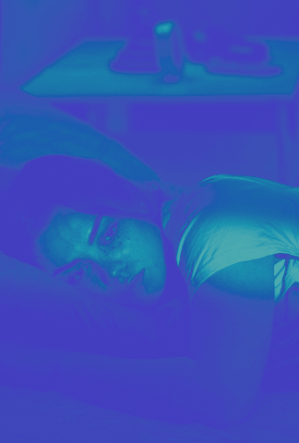
Potential Side Effects
  Fatigue
  Dizziness
  Headache
  Daytime sleepiness
  Increased Poison Control Calls (Especially for Children)
  Higher doses of melatonin make dreams (and nightmares) more vivid and make us more likely to remember them after waking.
SLEEPEDUCATION.ORG
Notes:
Potential Side Effects:
Common side effects can include fatigue, dizziness, headache, and daytime sleepiness.
Increased Poison Control Calls (Especially for Children): There has been a significant increase in calls to U.S. poison control centers regarding children ingesting melatonin, with many instances leading to hospitalizations. Melatonin gummies, often appealing to children, often lack childproof packaging.
Research has pointed to a fascinating side effect of melatonin: weird, vivid dreams that you may not otherwise have without the extra boost of melatonin before bed
One theory is that because melatonin increases time spent in REM cycles (when we dream), nightmares have a higher chance of appearing. Taking melatonin to help sleep when you’re experiencing emotional distress also presents a conundrum: are resulting nightmares a product of the melatonin, or the distress that caused poor sleep in the first place?

Slide 14
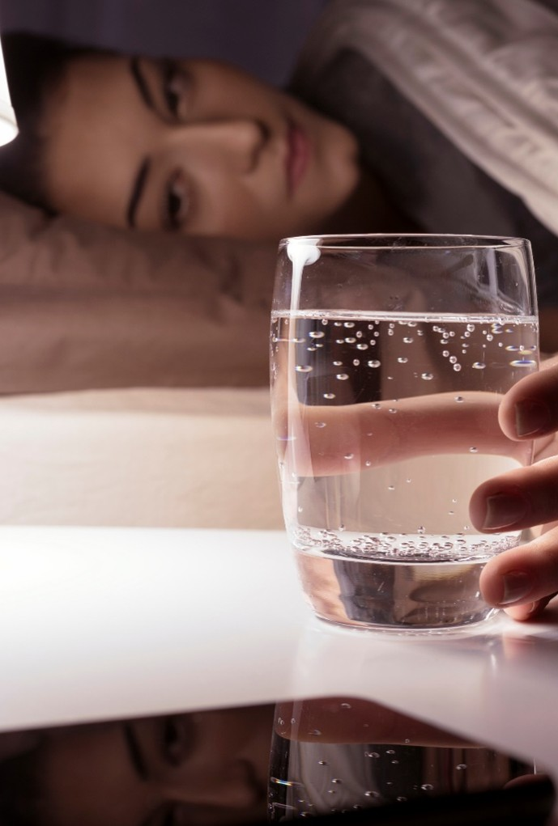
Melatonin levels in gummies
Key findings:
Quantity of melatonin ranged from 1.3 mg to 13.1 mg per serving size
In products that contained melatonin, the actual quantity of melatonin ranged from 74% to 347% of the labeled quantity.
Twenty-two of 25 products were inaccurately labeled, and only 3 products (12%) contained a quantity of melatonin that was within ±10% of the declared quantity.
Five products declared CBD as an ingredient, and the quantity of CBD ranged from 10.6 mg to 31.3 mg per serving.
The actual quantity of CBD ranged from 104% to 118% of the labeled quantity.
Cohen PA, Avula B, Wang Y, Katragunta K, Khan I. Quantity of Melatonin and CBD in Melatonin Gummies Sold in the US. JAMA. 2023;329(16):1401–1402. doi:10.1001/jama.2023.2296
SLEEPEDUCATION.ORG
Notes:
Quantity of Melatonin and CBD in Melatonin Gummies Sold in the US | Adolescent Medicine | JAMA | JAMA Network:
In September 2022, products formulated as gummies with “melatonin” on the label were identified in the National Institutes of Health’s Dietary Supplement Label Database, the most comprehensive database of dietary supplements sold in the US.4 The 30 unique brands entered into the database in 2021 were purchased online. Products’ labels were examined after purchase and excluded if “melatonin” did not appear on the actual label. Authors say (to the best of their knowledge) that this is the first US study to quantify melatonin in over-the-counter melatonin products.
25 products were analyzed. (4 were unavailable for purchase and 1 did not contain “melatonin” on the actual label)
Results: The great majority of melatonin gummy products were inaccurately labeled, with most products exceeding the declared amount of melatonin and CBD.

Slide 15
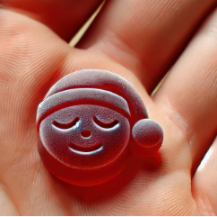
Melatonin: The unintentional overdoses
ONLY 0.1 mg to 0.3 mg of melatonin is required to increase plasma concentrations into the normal nighttime range.
Consuming melatonin gummies could expose children to between 40- and 130-times higher quantities of melatonin.
Unintentional ingestions could lead to consumption that greatly exceeds dosages of melatonin.
SLEEPEDUCATION.ORG
Notes:
Administration of as little as 0.1 mg to 0.3 mg of melatonin to young adults can increase plasma concentrations into the normal nighttime range.
Consuming melatonin gummies as directed could expose children to between 40- and 130-times higher quantities of melatonin.
Unintentional ingestions could lead to consumption that greatly exceeds these dosages of melatonin.

Slide 16

Melatonin: The unintentional overdoses
Prior to the COVID-19 pandemic, melatonin was used by an estimated 1.3% of children in the US, most commonly for sleep, stress, and relaxation
2016 to 2020: Sales of melatonin in the United States increased by approximately 150%
2012 to 2021: Calls to poison control centers for melatonin overdoses in kids rose by 530%
  28,000 visits to ERs and emergency clinics
  Over 4000 hospitalizations
  287 admissions to an intensive care unit
Lelak K, Vohra V, Neuman MI, Toce MS, Sethuraman U. Pediatric Melatonin Ingestions —
United States, 2012–2021. MMWR Morb Mortal Wkly Rep 2022;71:725–729.
SLEEPEDUCATION.ORG
Notes:
The largest annual increase in pediatric melatonin ingestions coincided with the onset of the COVID-19 pandemic. This might be related to increased accessibility of melatonin during the pandemic, as children spent more time at home because of stay-at-home orders and school closures.
Reports of increasing sleep disturbances during the pandemic might have led to increased availability of melatonin in the home. Next to multivitamins, melatonin is now the second most popular "natural" product parents give to their children. The availability of melatonin as gummies or chewable tablets makes it more tempting to give to children and more likely for them to overdose. The dose recommended in children is significantly lower than what is recommended in adults, and if you take too much of anything you have an overdose.
People don’t realize that taking melatonin is something that should be taken seriously, and for kids, you should run it by the pediatrician first.

Slide 17
Melatonin levels differ from advertised amounts
FDA Study: Key Findings
Of the 110 products tested:
Only 65 met the label’s claim for melatonin (between 76 and 126 % of the claimed amount)
20 had between 0 and 76%, and
35 had between 126 and 667%
Products from Zarbee’s, Robitussin and Creekside Natural Therapeutics varied the most from the melatonin declared.
WellYeah, Calmable and Nextdia, sold products that contained zero or close to zero detectable melatonin per serving.
Amenabar, T., & Gilbert, C. (2025, June 25). Melatonin doses can vary from what’s on the label. Here’s how much. The Washington Post. https://www.washingtonpost.com/wellness/2025/06/25/melatonin-children-sleep-fda-study/
SLEEPEDUCATION.ORG
Notes:
Supplement companies are required to have “at least 100 percent of labeled dosage” in their products. “It’s not uncommon for companies to put in a little extra. So, for instance, a melatonin product that’s labeled as 3 milligrams might put in 4 milligrams.” Because of the long shelf life of many supplements, upping dosages ("ingredient overage") is routinely done by manufacturers to ensure that products maintain their potency mandated by the U.S. Food and Drug Administration over time.
An FDA study, the largest of melatonin-containing products in the United States just published in June 2025, investigated 110 melatonin supplements marketed for children found doses ranged from 0 to 667 percent of the amount on the label.
The Washington Post filed a Freedom of Information Act request in November to obtain the names of the supplements tested.
Findings (details)
Half of the products tested met the label’s claim for melatonin, which means they fell between 76 and 126 percent of the claimed amount.
Creekside Children’s Sleep Aid, a supplement with a listed 0.5 mg of melatonin preserving, contained 3.33 mg per serving, or 667 % more than the amount on the label.
Robitussin’s Naturals cough + syrup listed 0.5 mg of melatonin per serving and contained 2.43 mg per serving, or 486 % more than the amount on the label.
Zarbee’s Sleep with Melatonin gummies listed 3 mg of melatonin per serving, and one sample tested contained 6.24 mg per serving, or 208 % more than the amount on the label.

Slide 18
Skip The Melatonin Here are some sleep hygiene options
SLEEPEDUCATION.ORG
Notes:
Despite its popularity, you may not want to rely on melatonin supplements on a regular basis. Relying on any type of sleep aid isn’t usually a good long-term solution.

Slide 19
Practical Strategies for Children's Sleep: Creating a Routine
Consistency
is Key
Wind-Down Routine
Optimal Sleep Environment
Establish a consistent bedtime and wake-up time, even on weekends
Regularity helps regulate their internal body clock
Warm bath
Reading a book (avoid screens)
Quiet play or gentle stretching
Soft lullabies or calming music
Use blackout curtains
Minimize noise; consider a white noise machine
Keep the room temperature between 68−72∘F
Comfortable mattress, pillow, and bedding.
SLEEPEDUCATION.ORG

Slide 20
Practical Strategies for Children's Sleep: Daytime Habits & Boundaries
Healthy Daytime Habits
Naps
Screen Time Management
Regular physical activity (but not too close to bedtime)
Exposure to natural light during the day
Avoid heavy meals or sugary snacks close to bedtime
Limit screen time, especially 1-2 hours before bed (blue light interferes with melatonin)
Keep screens (TVs, tablets, phones) out of the bedroom
Age-appropriate naps are important for younger children.
Avoid naps too late in the day, which can interfere with nighttime sleep
Allow a special blanket or stuffed animal for comfort
SLEEPEDUCATION.ORG

Slide 21
What to Avoid Before Bed
Electronics
Caffeine and alcohol
Eating or drinking too much
Turn off electronic devices at least 30 minutes before bedtime.
Avoid having caffeine in the afternoon or evening.
Avoid drinking alcohol before bed.
Don’t eat a large meal before bedtime. If you are hungry at night, eat a light, healthy snack. Reduce drinking fluids before bed.
SLEEPEDUCATION.ORG
Notes:
We have become a connected world. Consider creating time and space to unplug before bed. The blue light from devices can delay your release of melatonin and make it harder to fall asleep. You should allow 30 to 60 minutes of device-free time before bed. Consider listening to soft music or white noise.
Caffeine takes hours to leave your system. A good rule-of-thumb is to stop consuming caffeine 6 to 8 hours before bedtime. Even though people refer to it as a “night cap,” alcohol can lead to poorer quality sleep and should be avoided before bedtime. Limiting fluids before bed is another way to help you stay asleep through the night.

Slide 22
Practical Strategies for Parents’ Sleep:
Prioritizing Yourself
Make Sleep
Non-negotiable
Establish Your Own Routine
Optimize your Sleep Environment
Recognize that your sleep is essential for your family's well-being
Communicate your sleep needs with your partner or support system
Aim for consistent bedtimes and wake-up times
Create a relaxing pre-sleep ritual (reading, meditation, journaling)
Keep your bedroom dark, quiet, and cool
Keep the room temperature between 68−72∘F
Invest in a comfortable mattress, pillow, and bedding.
SLEEPEDUCATION.ORG

Slide 23
Practical Strategies for Parents’ Sleep:
Habits & Support
Daytime Habits Matter
Manage Stress & Anxiety
Seek Support
Regular physical activity (avoid close to bedtime)
Limit caffeine and alcohol, especially in the afternoon/evening
Nutrient-rich diet
Short naps (20-30 min)
Practice mindfulness or meditation
Engage in hobbies or activities you enjoy
Delegate tasks when possible
Consider short breaks during the day
Share nighttime duties with a partner if applicable
Don't hesitate to ask for help from family or friends
If sleep issues persist, consult a healthcare professional
SLEEPEDUCATION.ORG

Slide 24
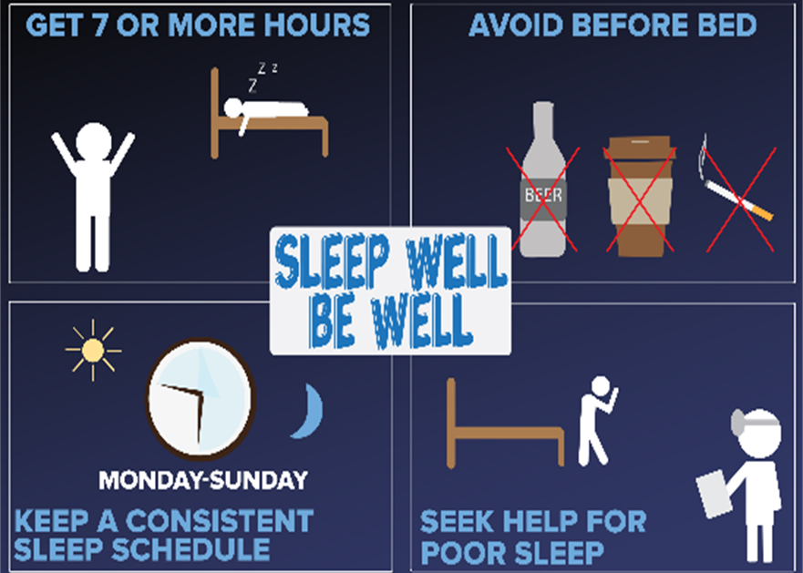

Sleep Hygiene Tips
SLEEPEDUCATION.ORG
Notes:
Healthy Sleep Duration Infographic

Slide 25

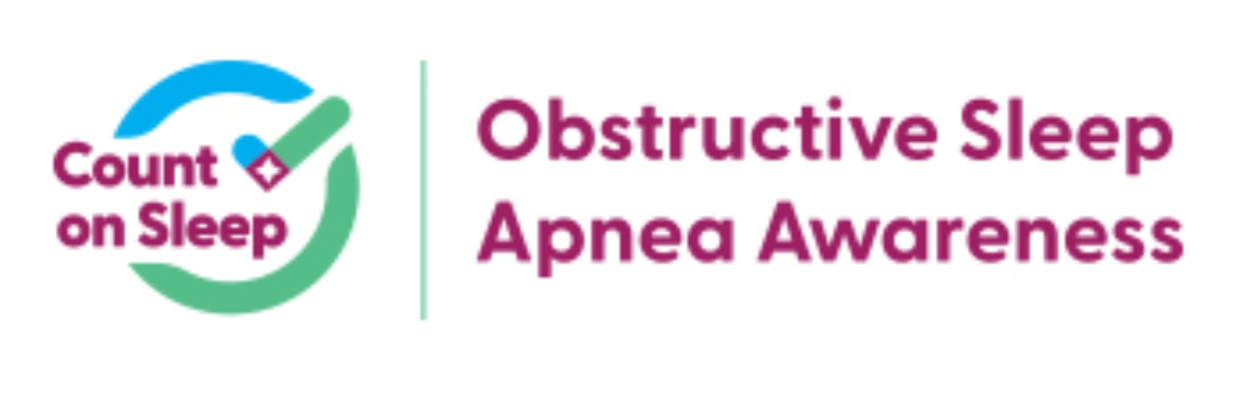


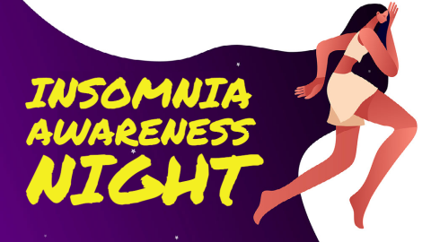
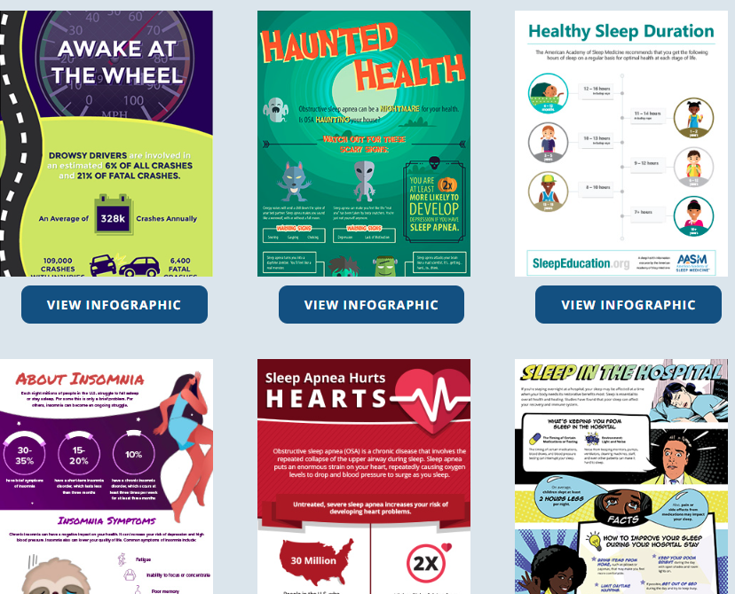
AASM resources
Patient Information Guides
Download Infographics
SLEEPEDUCATION.ORG
Notes:
The AASM’s Sleep Education website provides accurate patient education information. Visit sleepeducation.org to learn about healthy sleep and sleep disorders. The site also has a sleep center directory so you can get help for a sleep problem.
Insomnia Awareness Night: Typically held in June, Insomnia Awareness Night, organized by the American Academy of Sleep Medicine and the Society of Behavioral Sleep Medicine, we highlight the effective treatments, and trained providers are available to help people who have chronic insomnia.
We have many useful infographics that are free to download. Some of them are in English as well as Spanish

Slide 26
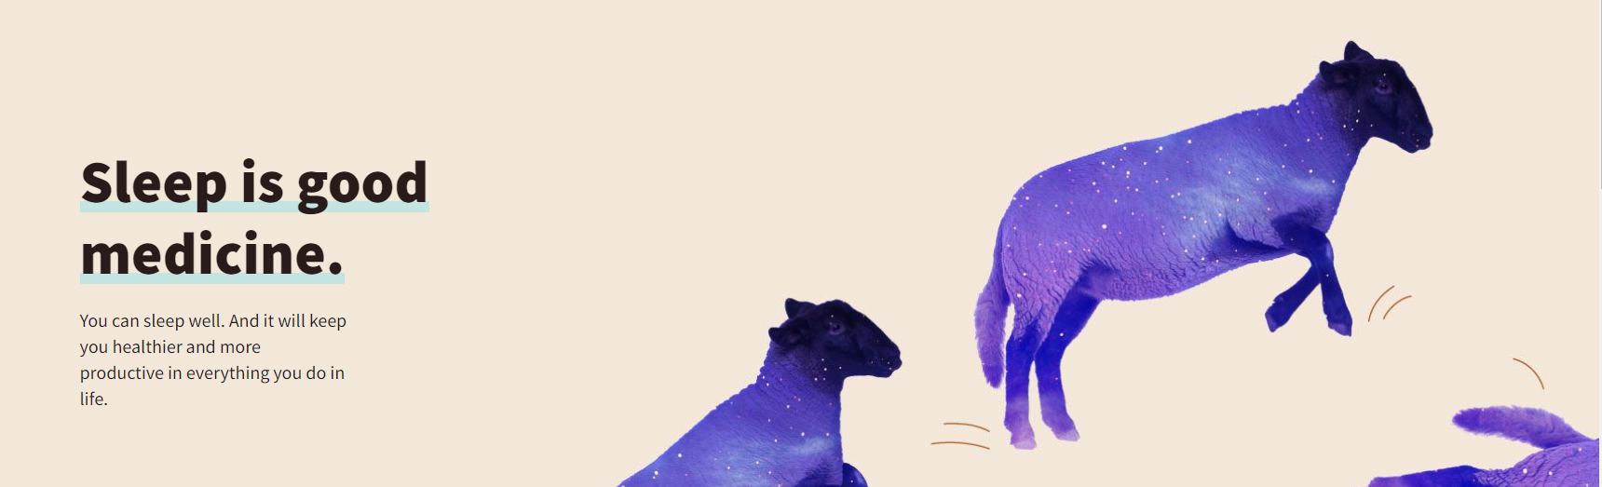
Sleep is Good medicine
Public Awareness Campaign
Notes:
The AASM launched the Sleep is Good Medicine campaign to increase public education about the importance of sleep and its connection to health. The campaign is encouraging people to talk to their doctor about their sleep concerns and providing tips to support health care professionals in helping their patients improve their sleep health.

