Slide 1
Sleep Medicine:
Is it for you?
A guide for interested trainees

Slide 2
Goals and Objectives
Learn about the evolution of the sleep medicine field
Recognize the education and training required to pursue a career in sleep medicine
Be aware of the opportunities for sleep physicians and the people they work closely with
Understand how to access resources to get involved in sleep medicine

Slide 3
Outline
What is Sleep Medicine?
The Evolution of Sleep Medicine
Why Choose Sleep Medicine?
Path to Sleep Medicine Training
Opportunities for Sleep Physicians
The Sleep Medicine Team
How to Get Board Certified in Sleep Medicine
Resources to Get Involved with Sleep Medicine
Notes:
-”What, why and how to choose sleep medicine”
-WHY sleep medicine- stable career, look up stats for diff societies,
-Brief history

Slide 4
What is Sleep Medicine?
Medical subspecialty
Diagnosis and treatment of sleep disorders in adults and children
Insomnia
Sleep-disordered breathing
Disorders of hypersomnolence
Circadian rhythm disorders
Parasomnias
Sleep-related movement disorders
Sleep-related epilepsy

Slide 5
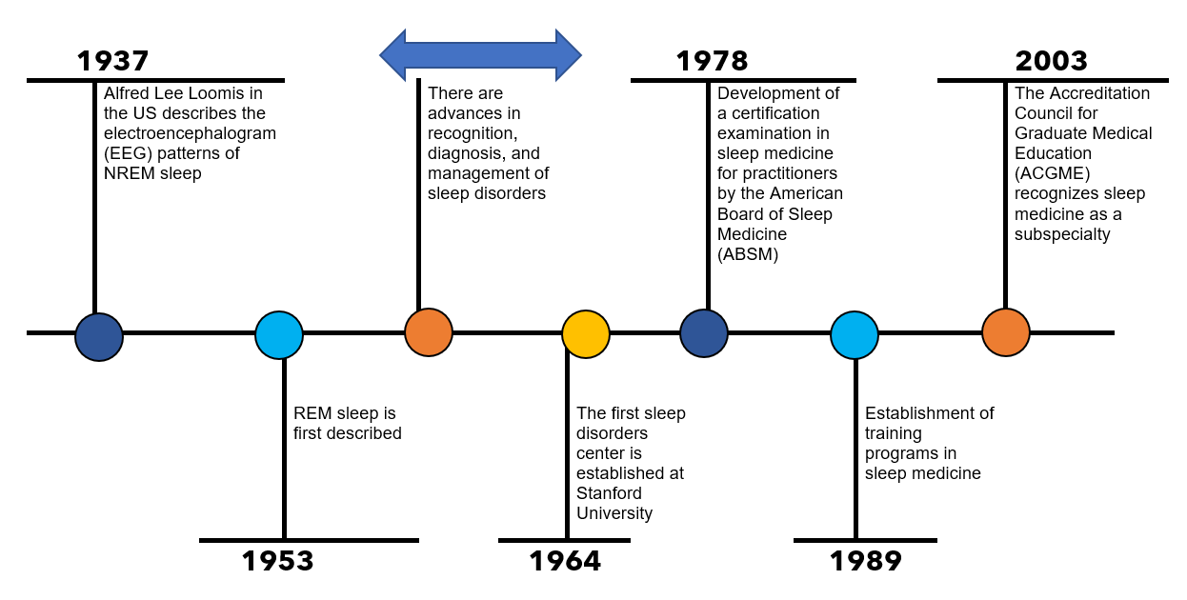
The Evolution of Sleep Medicine as a Career
Notes:
Mention growth over the years- 2003: There were about 50 sleep fellowship programs. Now in 2023 we have over 90.
https://www.ncbi.nlm.nih.gov/pmc/articles/PMC2413168/

Slide 6
Why Choose Sleep Medicine?
About 70 million people in the United States experience chronic sleep problems
Insufficient sleep has an estimated economic burden of $411 billion per year in the United States
Drowsy driving is responsible for more than 6,000 fatal car crashes per year
There is growing need for sleep physicians with a current estimated patient-to-sleep physician ratio of 43,000:1
There are ample sleep opportunities with more than 2,500 accredited sleep facilities in the U.S.
Notes:
https://www.sleepfoundation.org/how-sleep-works/sleep-facts-statistics#:~:text=Statistics%20About%20Sleep%20Disorders&text=It%20is%20believed%20that%20between,obstructive%20sleep%20apnea%20(OSA).
https://www.cdc.gov/sleep/about_us.html
https://jcsm.aasm.org/doi/10.5664/jcsm.6406

Slide 7
Sleep Medicine: A Day in the Life
It’s hard to sum up a single day in the life of a sleep physician!
Sleep medicine is a varied subspecialty that allows for flexibility and diversity in physician’s schedules including:
Outpatient clinics
Reading sleep studies
Inpatient consults
Opportunities to do part-time work in another specialty area
Opportunity to be a director of a sleep lab
Seeing adult and/or pediatric patients
Participating in advocacy work
Contributing to medical education
Conducting clinical or basic science research

Slide 8
The Sleep Medicine Team
Sleep medicine is a collaborative subspecialty
The sleep medicine team can vary but generally includes:
Sleep medicine physicians
Sleep medicine advanced practice providers
Sleep technologists
Sleep lab manager
Respiratory therapists
Sleep psychologists
Sleep medicine nurses
Sleep physicians also work closely with other specialists including dentists, pulmonologists, nutritionists, ENTs and bariatric surgeons

Slide 9
Path to Sleep Medicine Training
Successful completion of accredited medical degree
Completed residency:
Internal medicine
Psychiatry
Neurology
Pediatrics
Family medicine
Otolaryngology
Anesthesiology
Notes:
Mention:”Of note, some physicians choose to complete more than one fellowship. For example: Pulmonology/Critical Care fellowship + Sleep fellowship OR Epilepsy fellowship + Sleep fellowship”

Slide 10
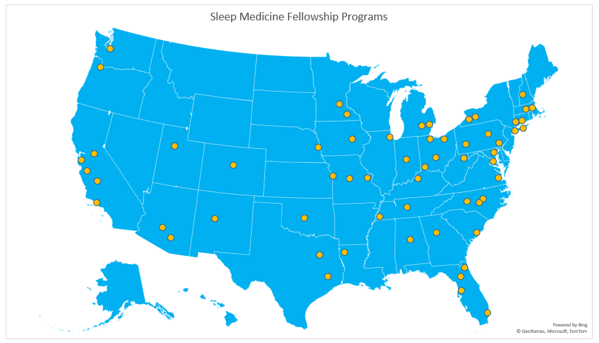
Sleep Medicine Fellowship
A sleep medicine fellowship is a year-long training program with both clinical experience and research opportunities
As of 2023, there are 99 accredited training programs across the country
178 physicians matched for the 2023 appointment year!
Notes:
https://freida.ama-assn.org/specialty/sleep-medicine
-Mention there is need for more training programs, especially in certain regions. For example: Southeast and west.

Slide 11
How to Get Board Certified in Sleep Medicine?
Complete training in residency at an accredited residency training program
Be board certified in a primary specialty (ABMS)
Complete a 12-month fellowship in sleep medicine at an ACGME-accredited sleep medicine fellowship program
Hold a valid, unrestricted license to practice medicine
Achieve a passing score on the sleep medicine certification exam through your primary specialty

Slide 12
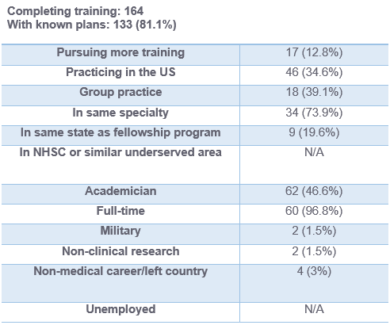
What Do Sleep Physicians Do After Training?
Adapted from the AMA FREIDA™ 2021 Data
Notes:
https://freida.ama-assn.org/specialty/sleep-medicine

Slide 13
What Can Board Certified Sleep Physicians Do?
Diagnose and treat a full range of sleep disorders
Interpret results of sleep testing such as polysomnography, multiple sleep latency testing, maintenance of wakefulness testing, actigraphy, and home sleep apnea tests
Establish a sleep lab
Start a sleep medicine fellowship program

Slide 14
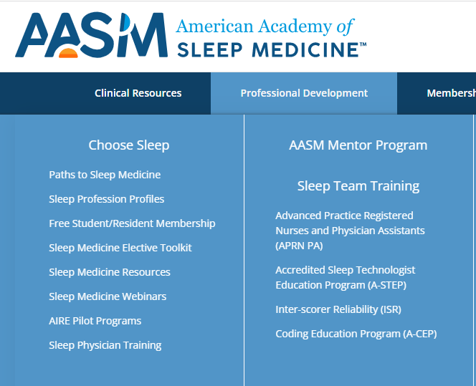
Sleep Medicine Resources
American Academy of Sleep Medicine
Free student and resident memberships
Mentor match program
Creating a sleep medicine elective
www.aasm.org

Slide 15
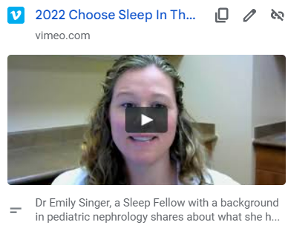
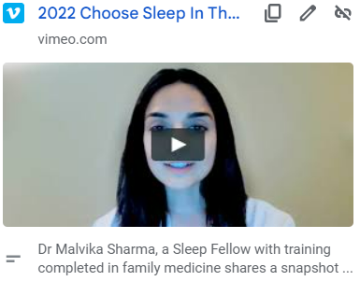
Hear From Former Sleep Medicine Fellows
2022 Choose Sleep In Their Words with Dr. Emily Singer, Sleep Fellow on Vimeo
2022 Choose Sleep In Their Words with Dr. Malvika Sharma, Sleep Fellow on Vimeo

Slide 16
References
CDC. (2022, September 13). About Our Program. Centers for Disease Control and Prevention. https://www.cdc.gov/sleep/about_us.html
Choose Sleep New. (n.d.). American Academy of Sleep Medicine – Association for Sleep Clinicians and Researchers. Retrieved December 1, 2022, from https://aasm.org/professional-development/choose-sleep/
FREIDA Sleep Medicine Residency and Fellowship Listing. (n.d.). Retrieved December 1, 2022, from https://freida.ama-assn.org/specialty/sleep-medicine
Shepard, J. W., Buysse, D. J., Chesson, A. L., Dement, W. C., Goldberg, R., Guilleminault, C., Harris, C. D., Iber, C., Mignot, E., Mitler, M. M., Moore, K. E., Phillips, B. A., Quan, S. F., Rosenberg, R. S., Roth, T., Schmidt, H. S., Silber, M. H., Walsh, J. K., & White, D. P. (2005). History of the Development of Sleep Medicine in the United States. Journal of Clinical Sleep Medicine : JCSM : Official Publication of the American Academy of Sleep Medicine, 1(1), 61–82.
Sleep Statistics. (2021, October 25). Sleep Foundation. https://www.sleepfoundation.org/how-sleep-works/sleep-facts-statistics
Watson, N. F., Rosen, I. M., & Chervin, R. D. (n.d.). The Past Is Prologue: The Future of Sleep Medicine. Journal of Clinical Sleep Medicine, 13(01), 127–135. https://doi.org/10.5664/jcsm.6406

