Slide 1
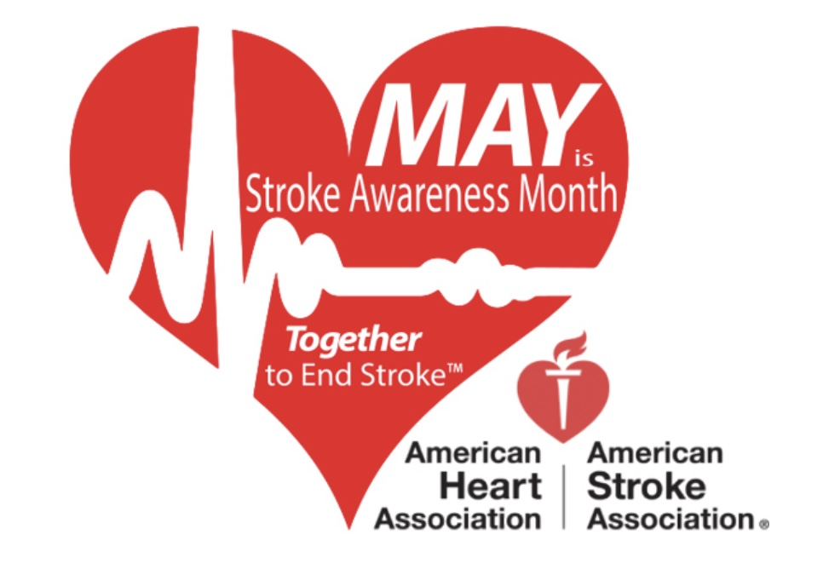
Sleep Apnea and Stroke
AASM Fellow Seminar
Feb 8, 2023
9-10 am AZ MST
Joyce K. Lee-Iannotti, MD
Director, Banner University Medical Center-Phoenix Sleep Disorder Center
Program Director, Sleep Medicine Fellowship, U of A COMP
Associate Professor, University of Arizona College of Medicine-Phoenix
Faculty, Vascular Neurology, Banner CSC
Vice Chair, Sleep Section, American Academy Neurology (AAN)
Director, AASM Foundation Board of Directors
Notes:
I’m boarded in stroke and sleep neurology and I’m excited to be able to present on both topics.
Muna Irfan
Sally Podolski
SMFDC

Slide 2
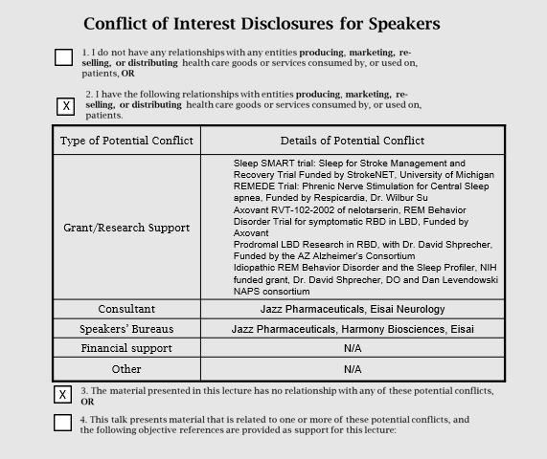

Slide 3
Overview
Case presentation
Sleep-disordered breathing post-stroke
Sleep apnea as an independent risk factor for stroke
Effectiveness of CPAP therapy in reducing recurrent stroke risk
Screen and Diagnosing sleep apnea in stroke patients
Summary

Slide 4
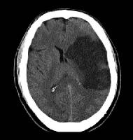
Case
73 yo RH German man
PMH: HTN, HPL, CAD, CHF (EF 30%), V-fib s/p ICD, paroxysmal AF
Recent left MCA stroke secondary to AF-related cardiac emboli with residual right HP and expressive aphasia
Notes:
Plegic right arm, moves right leg

Slide 5
Case
Noted to have abnormal overnight oximetry while in stroke rehab
Evidence of periodic desaturations in saw-tooth pattern with lowest O2 saturation of 82%, a pattern suggestive of sleep apnea.

Slide 6
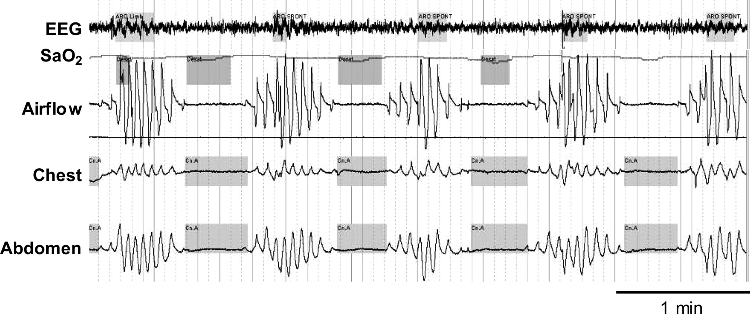
PSG
Reduced sleep efficiency 58%
Decreased REM sleep 5%
Multiple central apneic events
  CAI 51.6 events/hour
Central sleep apnea with Cheyne Stokes breathing
Notes:
Figure 3. An example of a patient with CSB. Note the characteristic crescendo/decrescendo pattern of breathing, long circulation time (each oxygen desaturation corresponds to the previous apnea), and arousal occurring at the peak of respiratory effort. See Figure 2 legend for expansion of abbreviation.

Slide 7
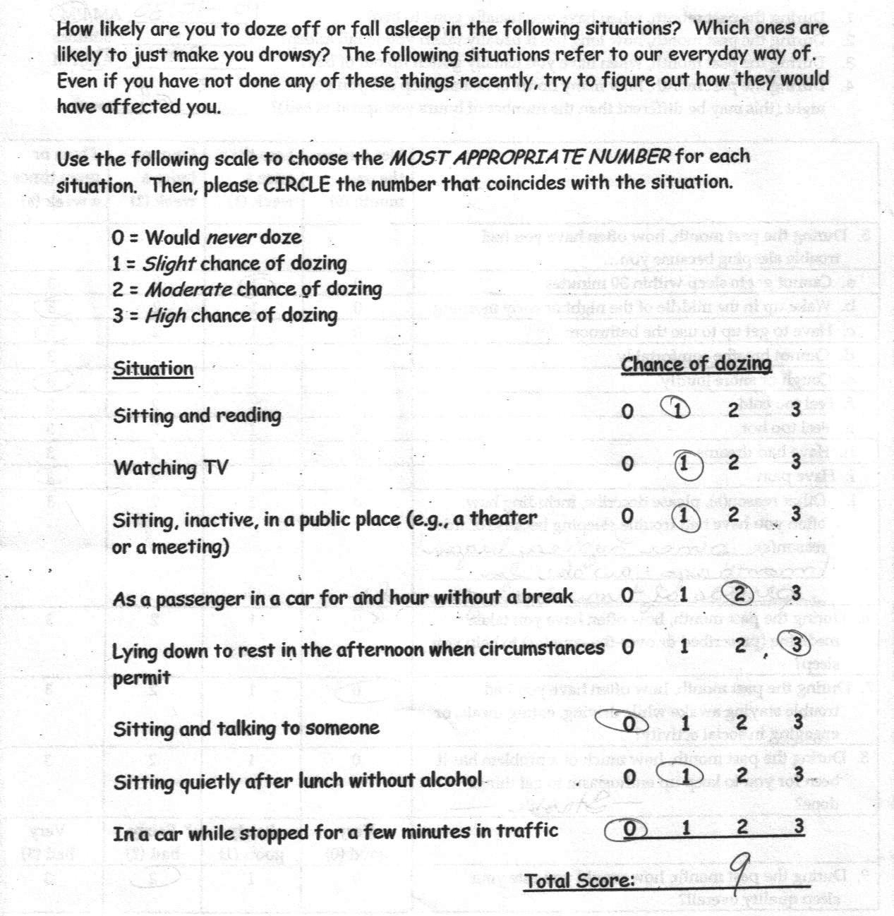
ESS

Slide 8
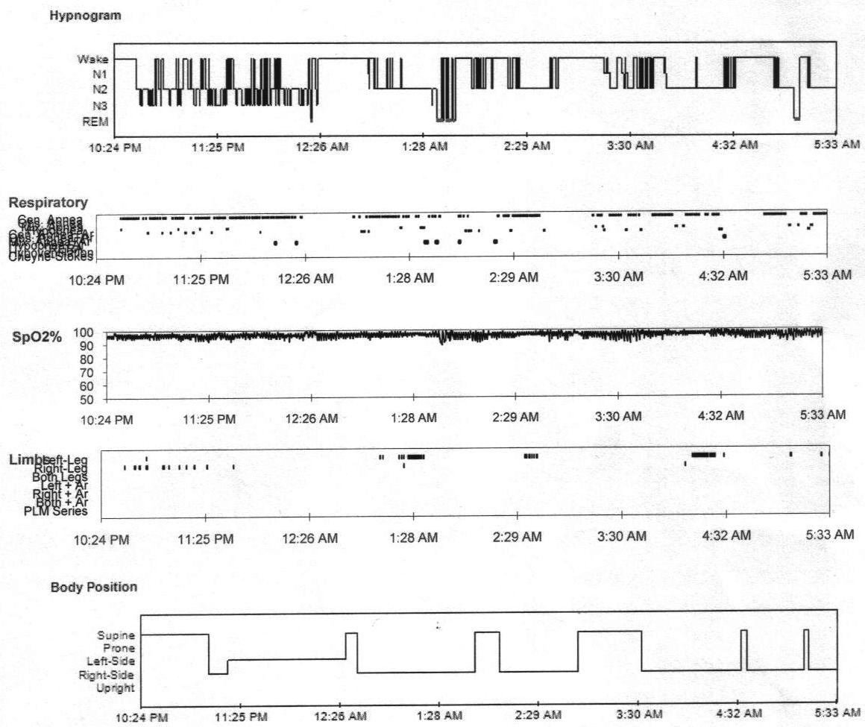

Slide 9
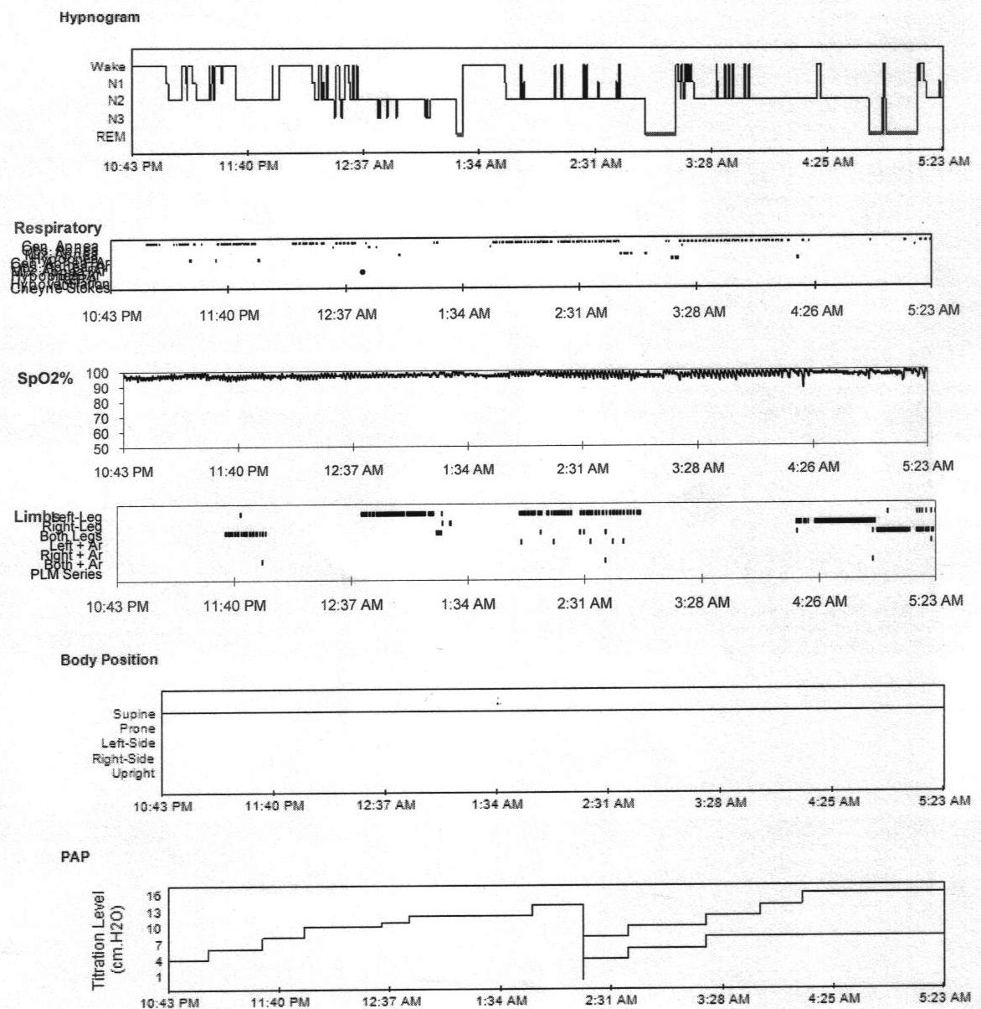
14/8
16/8
11
12
14
12/8
6
8
10
8/4
10/6
4
Notes:
84.7% reduction from baseline
“Good” grading:
AHI ≤ 10 (or ≥ 50% reduction of baseline AHI<15)
REM-supine sleep
Journal of Clinical Sleep Medicine, Vol. 4, No. 2, 2008
The patient reported feeling better the morning after the study

Slide 10
Case
Pt used Bilevel PAP at 16/8 cm H2O with a back-up rate of 16 for approximately 6 months
  No stroke recurrence
  Patient symptomatically improved, able to cooperate with rehabilitation
  NIHSS 12→5
Repeat study showed resolution of CSA, no OSA → PAP discontinued
Notes:
Possible questions:
Why wasn’t supplemental oxygen tried?
Why wasn’t adaptive seroventilation tried?

Slide 11
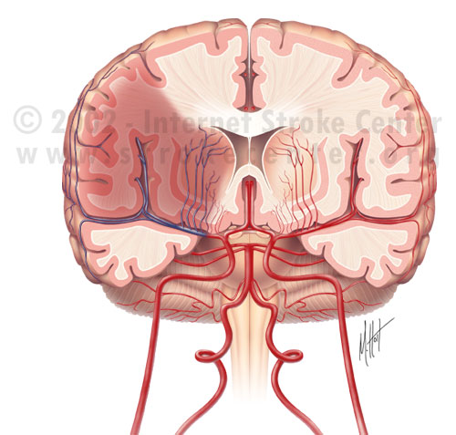
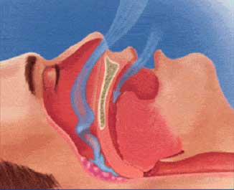
Notes:
Post stroke sleep complications

Slide 12
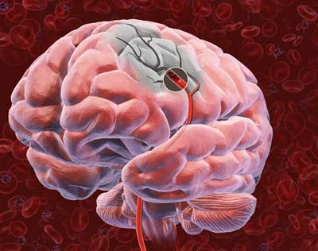
Stroke
2nd - cause of death (worldwide)
3rd - cause of death (USA, #1 heart & #2 cancer)
#1 leading cause of disability in US
Affects >700,000 individual annually
150,000 people die per year from stroke
Stroke health care cost >$40 billion/year

Slide 13
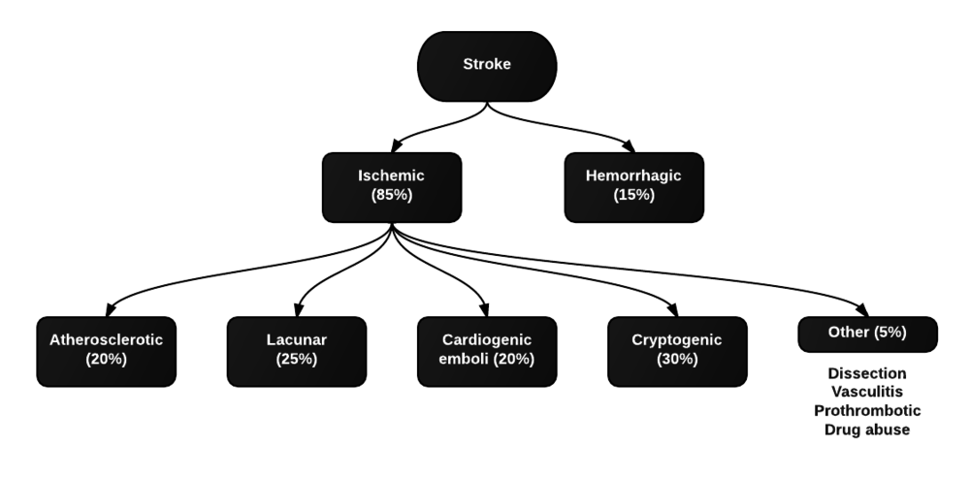
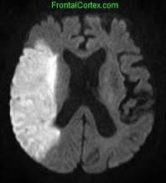
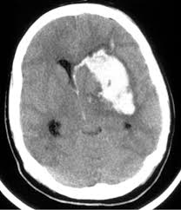
Notes:
Stroke 101

Slide 14
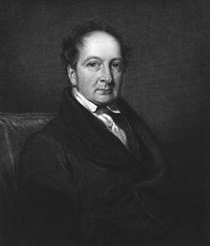
Post-stroke Sleep Disordered Breathing
First cases of sleep-related breathing disorders in stroke pts reported in early 19th century
1800’s: John Cheyne first described periodic breathing patterns in pts with cardiac disease and “apoplexy”
Cheyne stokes breathing later linked to bi-hemispheric strokes
1955: Weir Mitchell linked brainstem stroke to central apnea
Notes:
John Cheyne (February 3, 1777, Leith, Scotland - January 31, 1836, Buckinghamshire, England) was a British physician, surgeon and author of monographs on a number of medical topics. He was one of the people to identify Cheyne-Stokes respiration.

Slide 15
SDB Post-stroke
Estimated 60-72% of all stroke pts have sleep-disordered breathing (AHI >10)
Similar frequency and severity of sleep apnea have been found among various stroke types and locations
Prevalence of sleep-disordered breathing (SDB) appears to be similar in TIA’s and ischemic stroke syndromes
Bassetti et al. Neurology 1996;47:1167-1173.
Johnson & Johnson. JCSM 2010;6(2):131-137.
Parra et al. Am J Respir Crit Care Med 2000;161:375-380.
Bassetti et al. Sleep 1999;22:217-223.
Notes:
However, a more recent meta-analysis from Hong Kong demonstrated that the prevalence of sleep apnea appeared to be greater in patients with cardioembolic strokes (cardioembolic: 74.3%, large artery atherosclerosis: 68.3%, small vessel occlusion: 56.1%, other/unknown causes: 47.9%), hemorrhagic strokes (82.7% vs. 67.5%, p=0.098), strokes that were supratentorial in location (67.9% vs. 56.5%), and in the acute-subacute phase of stroke (acute 68.4% vs. subacute 71.3% vs. chronic 60.6%) (7). The evolving literature reflects increasing understanding of pathophysiological mechanisms of OSA as a risk factor for stroke.
Liu X, Lam DC, Chan KPF, Chan HY, Ip MS, Lau KK. Prevalence and Determinants of Sleep Apnea in Patients with Stroke: A Meta-Analysis. J Stroke Cerebrovasc Dis. 2021 Dec;30(12):106129. doi: 10.1016/j.jstrokecerebrovasdis.2021.106129. Epub 2021 Sep 30. PMID: 34601243.
Parra study:
To investigate the prevalence and behavior of sleep-related breathing disorders (SRBDs) associated with a first-ever stroke or transient ischemic attack (TIA), we prospectively studied 161 consecutive patients admitted to our stroke unit. Complete neurological assessment was performed to determine parenchymatous and vascular localization of the neurological lesion. Stroke subtype was categorized as TIA, ischemic (IS), or hemorrhagic (HS). A portable respiratory recording (PRR) study was performed within 48-72 h after admission (acute phase), and subsequently after 3 mo (stable phase). During the acute phase, 116 patients (71.4%) had an apnea-hypopnea index (AHI) > 10 events/h and 45 (28%) had an AHI > 30. No relationships were found between sleep-related respiratory events and the topographical parenchymatous location of the neurological lesion or vascular involvement. Cheyne-Stokes breathing (CSB) was observed in 42 cases (26.1%). There were no significant differences in SRBD according to the stroke subtype except for the central apnea index (CAI). During the stable phase a second PRR was performed in 86 patients: 53 of 86 had an AHI > 10 and 17 of 86 had an AHI > 30. The AHI and CAI were significantly lower than those in the acute phase (16.9 ± 13.8 versus 22.4 ± 17.3 and 3.3 ± 7.6 versus 6.2 ± 10.2, respectively) (p < 0.05) while the obstructive apnea index (OAI) remained unchanged. CSB was observed in 6 of 86 patients. The prevalence of SRBD in patients with first-ever stroke or TIA is higher than expected from the available epidemiological data in our country. No correlation was found between neurological location and the presence or type of SRBD. Obstructive events seem to be a condition prior to the neurological disease whereas central events and CSB could be its consequence. Parra O, Arboix A, Bechich S, García-Eroles L, Montserrat JM, López JA, Ballester E, Guerra JM, Sopeña JJ. Time course of sleep-related breathing disorders in first-ever stroke or transient ischemic attack

Slide 16
Time Course of SDB post-stroke
SDB typically improves from the acute to subacute phases of stroke, but about 50% still exhibit AHI >10 three months post-stroke
Central events improve more quickly than obstructive events
One study showed better improvement of SDB in hemorrhagic rather than ischemic strokes
Parra et al. Am J Respir Crit Care Med 2000;161:375-380.
Szucs et al. Eur Neurol 2002;47:15-19.
Notes:
Parra study:
To investigate the prevalence and behavior of sleep-related breathing disorders (SRBDs) associated with a first-ever stroke or transient ischemic attack (TIA), we prospectively studied 161 consecutive patients admitted to our stroke unit. Complete neurological assessment was performed to determine parenchymatous and vascular localization of the neurological lesion. Stroke subtype was categorized as TIA, ischemic (IS), or hemorrhagic (HS). A portable respiratory recording (PRR) study was performed within 48-72 h after admission (acute phase), and subsequently after 3 mo (stable phase). During the acute phase, 116 patients (71.4%) had an apnea-hypopnea index (AHI) > 10 events/h and 45 (28%) had an AHI > 30. No relationships were found between sleep-related respiratory events and the topographical parenchymatous location of the neurological lesion or vascular involvement. Cheyne-Stokes breathing (CSB) was observed in 42 cases (26.1%). There were no significant differences in SRBD according to the stroke subtype except for the central apnea index (CAI). During the stable phase a second PRR was performed in 86 patients: 53 of 86 had an AHI > 10 and 17 of 86 had an AHI > 30. The AHI and CAI were significantly lower than those in the acute phase (16.9 ± 13.8 versus 22.4 ± 17.3 and 3.3 ± 7.6 versus 6.2 ± 10.2, respectively) (p < 0.05) while the obstructive apnea index (OAI) remained unchanged. CSB was observed in 6 of 86 patients. The prevalence of SRBD in patients with first-ever stroke or TIA is higher than expected from the available epidemiological data in our country. No correlation was found between neurological location and the presence or type of SRBD. Obstructive events seem to be a condition prior to the neurological disease whereas central events and CSB could be its consequence. Parra O, Arboix A, Bechich S, García-Eroles L, Montserrat JM, López JA, Ballester E, Guerra JM, Sopeña JJ. Time course of sleep-related breathing disorders in first-ever stroke or transient ischemic attack

Slide 17
Other Forms of Breathing Disturbance
Breathing pattern | Location of lesions
OSA | Supra- and infratentorial
CSA +/- CSB | Supra- and infratentorial
Respiratory apraxia, impaired volitional breathing (pt unable to take deep breath or hold breaths) | Frontal cortex, BG, Internal capsule, ventral pons/medulla, anterior spinal cord
Neurogenic hyperventilation, RR>25/min *Poor prognostic sign | Ventro-tegmental pons (bilateral), medial medulla
Apneustic breathing (inspiratory breath-holding) | Bilateral ventro-tegmental pons (BA occlusion)
Ataxic breathing, Biot’s breathing | Tegmental medulla (bilateral)
Central (alveolar) hypoventilation, impaired automatic breathing | Tegmental medulla, anterior cervical spinal cord
Kryger et al. 4th ed
Notes:
Krieger, Principles and Practice of Sleep Medicine
A disturbed coodination of upper airway, intercostal, and diaphragm muscles due to brainstem or hemispheric lesions may favor the appearance of OSA.
CSB has been attributed to CO2 hypersensitivity induced by bilateral supratentorial or pontine lesions, decreased LOC and CHF and crucial for the appearance of CSB even during wake.
Conversely, CSB that occurs only during sleep can be seen also in patients with unliateral lesions of variable topography and without disturbed LOC or clinically overt CHF.
Characteristics
Decreased or abolished flow with normal respiratory effort
Decrease in respiratory flow and effort
Impaired voluntary modulation of breathing amplitude and frequency
Sustained respiratory rates >25-30/min in the absence of hypoxemia
Erratic variations in breathing frequency and amplitude
Erratic variations in breathing frequency and amplitude
Impaired or loss of automatic breathing (CA and hypoventilation)
Ataxic breathing = Biot breathing seen with lateral medullary stroke, usually bilateral

Slide 18
Importance of Treatment of SDB post-stroke
Lowers risk of aspiration and respiratory infections
Crucial part of secondary stroke prevention
Shown to improve nocturnal BP’s and sense of subjective well-being
Improves post-stroke depression scales
Wessendorf et al. Eur Respir J 2001;18:623-629.
Sandberg et al. Eur Respir J 2001;18:619-622.
Notes:
Challenges: variable compliance rates due to patient LOC, ability to cooperate, NH willingness to comply, etc.
Not my experience, my stroke pts are most compliant for fear of recurrent strokes.

Slide 19
Importance of Treatment of SDB post-stroke
Treatment of OSA by CPAP in stroke patients undergoing rehabilitation improved functional and motor, but not neurocognitive outcomes
TOROS study
  Aaronson et al, neurorehabilitation unit in Heliomare, Netherlands
  4 weeks CPAP versus control
  Cognitive and functional status compared to baseline
Ryan et al. Stroke 2011 Apr;42(4):1062-7.
Dutch Registry Trial, NTR3212
Aaronson et al. BMC Neurol 2014;14:14-36.
Notes:
Challenges: variable compliance rates due to patient LOC, ability to cooperate, NH willingness to comply, etc.
Not my experience, my stroke pts are most compliant for fear of recurrent strokes.

Slide 20
Treatment of SDB post-stroke
CPAP treatment of choice of OSA
Oxygen, CPAP, Bilevel PAP or ASV for CSA
Tracheostomy or mechanical ventilation in central hypoventilation or ataxic breathing syndromes
CPAP compliance variable 30-70%
  Challenges: dementia, delirium, aphasia, anosognosia (unaware of deficits), pseudobulbar or bulbar palsy
Wessendorf et al. Eur Respir J 2001;18:623-629.
Notes:
Challenges: variable compliance rates due to patient LOC, ability to cooperate, NH willingness to comply, etc.
Not my experience, my stroke pts are most compliant for fear of recurrent strokes.

Slide 21
Notes:
CSA/SRBD following stroke (new onset) typically short-lived and has been shown to resolve spontaneously

Slide 22
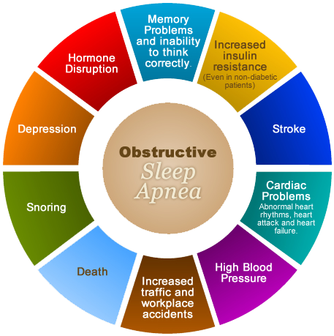
Consequences of OSA
Coronary artery disease
Heart failure
Stroke
Pulmonary HTN
Cor Pulmonale
Cardiac Arrhythmias (atrial fibrillation)
GERD
Increased frequency of seizures in epileptics
Increased headache syndromes (migraines)
Psychiatric/mood - depression, anxiety, irritability
Social and sexual dysfunction
Neurocognitive impairment/ Memory loss
Increased risk of cancer (all types)
COVID Severity
Shahar et al, AJRCCM 2001

Slide 23
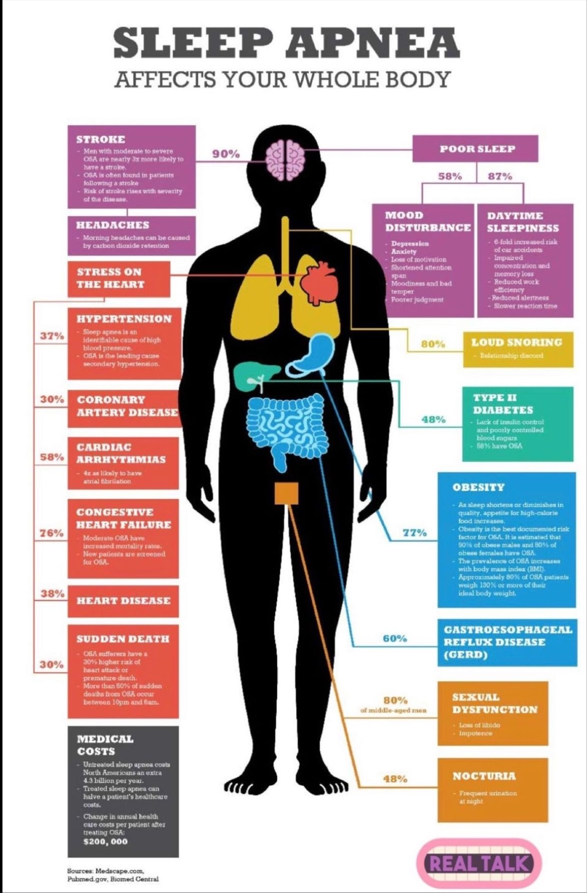

Slide 24
OSA as a stroke risk factor:
Proposed Mechanisms
Hypoxemia
Sympathetic activation (increase BP/HR)
Emergence of arrhythmias
Coagulation (increased blood clot formation)
Inflammatory markers (CRP, IL6, TNF, VEGF)
Metabolic deregulation (Insulin, leptin resistance)
Re-opening of PFO
Barone, D, Krieger A, Curr Atheroscler Rep 2013;15:334.
Notes:
Barone et al.
Elevation of tumor necrosis factor, proinflammatory nuclear transcription factor kappa B, circulating free radicals, lipid peroxidation, vascular endothelial growth factor and vascular adhesion molecules → formation of reactive oxygen species →activates transcription factors →promotes activation of endothelial cells, leukocytes, and platelets, leading to atherogenesis and potential thrombus formation.
Leptin resistance, reduced levels of adiponectin, and increased levels of ghrelin have been linked to OSA, and may accelerate the development of atherosclerosis resulting in increased risk of stroke.

Slide 25
Portela et al. Cerebrovascular Disease. 2009; 27:104-110.
Notes:
During long apneas, paradoxical embolization caused by right to left shunting in patients with PFO is another potential mechanism of stroke.

Slide 26
Sleep Apnea and HTN
Sleep Heart Health Study showed a dose-response relationship between SBD and HTN
  6132 subjects
  OR for development of HTN comparing severe OSA pts (AHI >30) with non-OSA pts was 1.37 (CI 1.03-1.83) even after adjustment for confounding variables
Quan et al. Sleep. 1997;20(12):1077-85.
Nieto et al. JAMA 2000;283(14):1829-36.
Notes:
Sleep. 1997 Dec;20(12):1077-85.
The Sleep Heart Health Study: design, rationale, and methods.
Quan SF, Howard BV, Iber C, Kiley JP, Nieto FJ, O'Connor GT, Rapoport DM, Redline S, Robbins J, Samet JM, Wahl PW.
Source
Department of Medicine and Respiratory Sciences Center, University of Arizona, Tucson 85724, USA.
Abstract
The Sleep Heart Health Study (SHHS) is a prospective cohort study designed to investigate obstructive sleep apnea (OSA) and other sleep-disordered breathing (SDB) as risk factors for the development of cardiovascular disease. The study is designed to enroll 6,600 adult participants aged 40 years and older who will undergo a home polysomnogram to assess the presence of OSA and other SDB. Participants in SHHS have been recruited from cohort studies in progress. Therefore, SHHS adds the assessment of OSA to the protocols of these studies and will use already collected data on the principal risk factors for cardiovascular disease as well as follow-up and outcome information pertaining to cardiovascular disease. Parent cohort studies and recruitment targets for these cohorts are the following: Atherosclerosis Risk in Communities Study (1,750 participants), Cardiovascular Health Study (1,350 participants), Framingham Heart Study (1,000 participants), Strong Heart Study (600 participants), New York Hypertension Cohorts (1,000 participants), and Tucson Epidemiologic Study of Airways Obstructive Diseases and the Health and Environment Study (900 participants). As part of the parent study follow-up procedures, participants will be surveyed at periodic intervals for the incidence and recurrence of cardiovascular disease events. The study provides sufficient statistical power for assessing OSA and other SDB as risk factors for major cardiovascular events, including myocardial infarction and stroke.

Slide 27
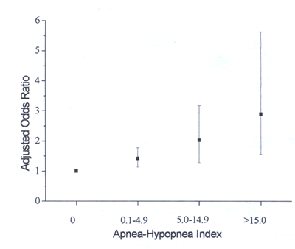
Obstructive Sleep Apnea and Hypertension
Wisconsin Sleep Cohort Study
  Dose-dependent relationship between severity of OSA and risk of HTN
  Odds for developing hypertension during a 4-8 year follow-up period compared to subjects with no apneas or hypopneas was 2.0 if AHI was 5-15, and 3.0 if AHI>15
Peppard et al. NEJM. 2000; 342:1378-1384.
Notes:
Background
Sleep-disordered breathing is prevalent in the general population and has been linked to chronically elevated blood pressure in cross-sectional epidemiologic studies. We performed a prospective, population-based study of the association between objectively measured sleep-disordered breathing and hypertension (defined as a laboratory-measured blood pressure of at least 140/90 mm Hg or the use of antihypertensive medications).
Methods
We analyzed data on sleep-disordered breathing, blood pressure, habitus, and health history at base line and after four years of follow-up in 709 participants of the Wisconsin Sleep Cohort Study (and after eight years of follow-up in the case of 184 of these participants). Participants were assessed overnight by 18-channel polysomnography for sleep-disordered breathing, as defined by the apnea–hypopnea index (the number of episodes of apnea and hypopnea per hour of sleep). The odds ratios for the presence of hypertension at the four-year follow-up study according to the apnea–hypopnea index at base line were estimated after adjustment for base-line hypertension status, body-mass index, neck and waist circumference, age, sex, and weekly use of alcohol and cigarettes.
Results
Relative to the reference category of an apnea–hypopnea index of 0 events per hour at base line, the odds ratios for the presence of hypertension at follow-up were 1.42 (95 percent confidence interval, 1.13 to 1.78) with an apnea–hypopnea index of 0.1 to 4.9 events per hour at base line as compared with none, 2.03 (95 percent confidence interval, 1.29 to 3.17) with an apnea–hypopnea index of 5.0 to 14.9 events per hour, and 2.89 (95 percent confidence interval, 1.46 to 5.64) with an apnea–hypopnea index of 15.0 or more events per hour.
Conclusions
We found a dose–response association between sleep-disordered breathing at base line and the presence of hypertension four years later that was independent of known confounding factors. The findings suggest that sleep-disordered breathing is likely to be a risk factor for hypertension and consequent cardiovascular morbidity in the general population.
Compared to those with AHI 0, the odds of having HTN was 42% greater if AHI was 0.1-5, 2x greater if AHI was 5-15, and almost 3x greater if AHI was more than 15

Slide 28
Overnight Polysomnogram in a Patient with Obstructive Sleep Apnea
EEG
EOG
EKG
SBP
Airflow
SAO2
RESP
Tilkian AG et al. Ann Intern Med. 1976 Dec;85(6):714-9.
Notes:
The arousal mechanism has been considered a stimulant of sympathetic activity and catecholamine levels have been shown to be increased after arousal. Carotid body stimulation appears to be pivotal to this sympathetic nervous activity and the development of increases in blood pressure.
Rothwell, Peter (Universiy of Oxford)
The Lancet, March 13, 2010; vol 375: pp 895-905. Evidence of fluctuating BP’s lead to increased risk stroke
‘We have shown that it is variations in people’s blood pressure rather than the average level that predicts stroke most powerfully. Occasional high values, and what might be called episodic hypertension, carry a high risk of stroke. Previously, such fluctuations were considered to be benign and uninformative,’ says Professor Rothwell.

Slide 29
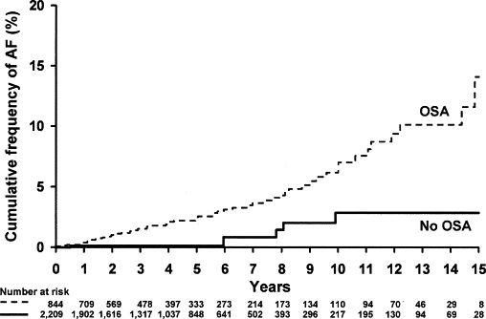
Sleep Apnea and Atrial Fibrillation
Incidence of atrial fibrillation (AF) for subjects <65 years of age with and without OSA during an average 4.7 years of follow-up, p = 0.002.
Adjusted OR for the association between AF and OSA was 2.19 (95% CI 1.40 to 3.42, P=0.0006).
Gami AS, et al. J Am Coll Cardiol. 2007;49:565-71.
Notes:
Background— Obstructive sleep apnea (OSA) is associated with recurrent atrial fibrillation (AF) after electrocardioversion. OSA is highly prevalent in patients who are male, obese, and/or hypertensive, but its prevalence in patients with AF is unknown.
Methods and Results— We prospectively studied consecutive patients undergoing electrocardioversion for AF (n=151) and consecutive patients without past or current AF referred to a general cardiology practice (n=312). OSA was diagnosed with the Berlin questionnaire, which is validated to identify patients with OSA. We also assessed its accuracy compared with polysomnography in a sample of the study population. Groups were compared with the 2-tailed t, Wilcoxon, and χ2 tests. Logistic regression modeled the association of AF and OSA after adjustment for relevant covariates. Patients in each group had similar age, gender, body mass index, and rates of diabetes, hypertension, and congestive heart failure. The questionnaire performed with 0.86 sensitivity, 0.89 specificity, and 0.97 positive predictive value in our sample. The proportion of patients with OSA was significantly higher in the AF group than in the general cardiology group (49% versus 32%, P=0.0004). The adjusted odds ratio for the association between AF and OSA was 2.19 (95% CI 1.40 to 3.42, P=0.0006).
Conclusions— The novel finding of this study is that a strong association exists between OSA and AF, such that OSA is strikingly more prevalent in patients with AF than in high-risk patients with multiple other cardiovascular diseases. The coinciding epidemics of obesity and AF underscore the clinical importance of these results.

Slide 30
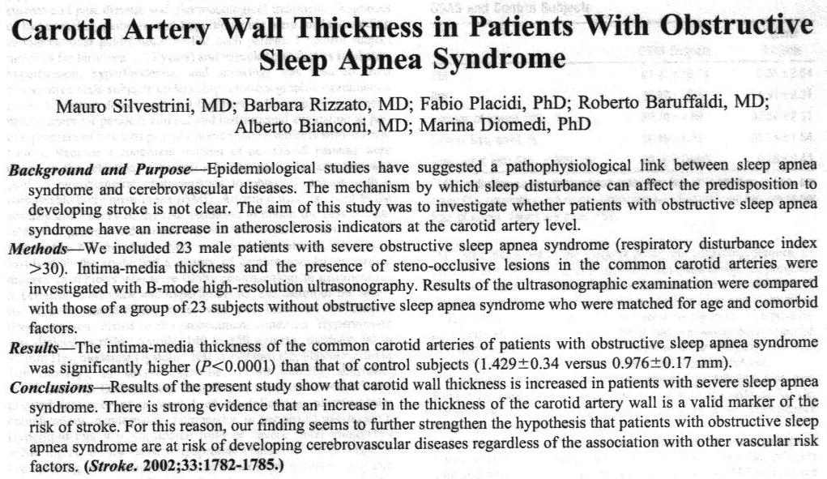
Atherogenesis in SDB
Studies have shown an increase in the intima-media thickness (IMT) of the common carotid artery in OSA pts compared with controls matched for age and vascular risk factors.

Slide 31
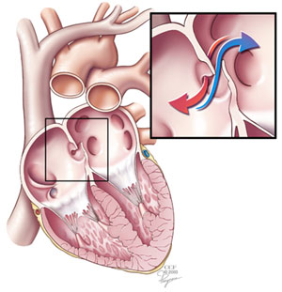
PFO reopening in SDB
Beelke et al (2003)
  Performed TCD with saline injection in 78 pts
  27% of pts with OSA compared to 15% of controls had a PFO (p<0.05)
  Speculated that apneic episodes resulted pathological R→L shunting following brief Valsalva effects at the termination of sleep apneas
  OSA increases the risk of paradoxical emboli
        Sleep Med 2003;4(3):219-223.

Slide 32
OSA related to stroke and death
Conducted at Yale Medical Center
1022 participants enrolled but only 898 completed
  573 (68%) with OSA (AHI >5, mean AHI 35±29)
  325 w/o OSA ( AHI<5, mean AHI 2±1.5)
Mean age 60 yrs
Follow up of 2-4yrs
Adjusted for age/sex/race, smoking, alcohol intake, BMI, DM, HTN, AF, high cholesterol
Yaggi et al, NEJM 2005; 353: 2034-2041

Slide 33
Results
OSA group - 22 strokes, 50 deaths
[3.48 events per 100 person-years]
Control group – 2 strokes, 16 deaths
[1.60 events per 100 person-years]
After adjustment for age, sex, race, tobacco use, ETOH, BMI, DM, HTN, AF, HPL, OSA retained a statistically significant association with stroke or death
  [Hazard ratio 1.97; 95% CI 1.12-3.48, P=0.01]
Yaggi et al, NEJM 2005; 353: 2034-2041
Notes:
TIA’s were counted as strokes!
Death was from any cause.

Slide 34
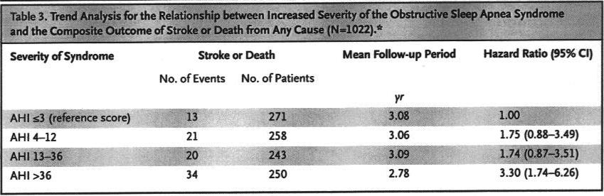
Trend analysis showed a step-wise increase in the risk of stroke/death as a function of increased severity of OSA (p=0.005)
The risk of stroke/death in pts in the most severe quartile of OSA was 3 x that in the controls
Yaggi et al, NEJM 2005; 353: 2034-2041

Slide 35
OSA and Stroke
Largest epidemiological studies in Sleep apnea, the Sleep Heart Health Study
5,422 subjects with full PSG’s
Followed 8.7 years
Redline et al. Am J Resp Crit Care Med 2010;18(2):269-77.

Slide 36
OSA and Stroke
193 strokes
Men: increased risk of stroke if AHI >20
  Adjusted hazard ratio of 2.86 (1.1, 7.4 CI, p=0.016)
  Each one unit increase in AHI increased stroke risk by 6%
Women: increased risk of stroke if AHI >25
Redline et al. Am J Resp Crit Care Med 2010;18(2):269-77.

Slide 37
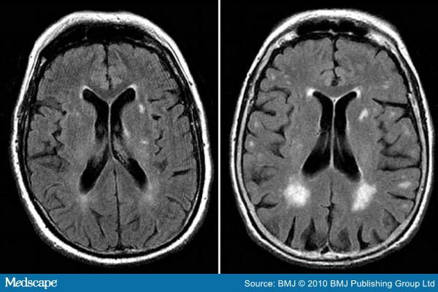
Brain scans in OSA
Brain MRI shows silent brain infarct in 25% of patient with moderate to severe OSA
  Minoguchi et al, Am J Respir Crit Care Med. 2007;175:612-617.
Presence and severity of WM disease on CT is associated with SDB and a higher AHI
  WMD severity correlated independently with AHI
    [R² = 0.07, p<0.05]
Harbison et al, Neurology. 2003;61:959-963.

Slide 38
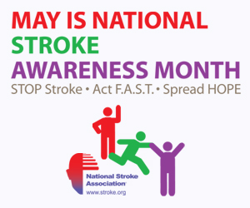
Primary and Secondary prevention:
How to screen stroke patients

Slide 39
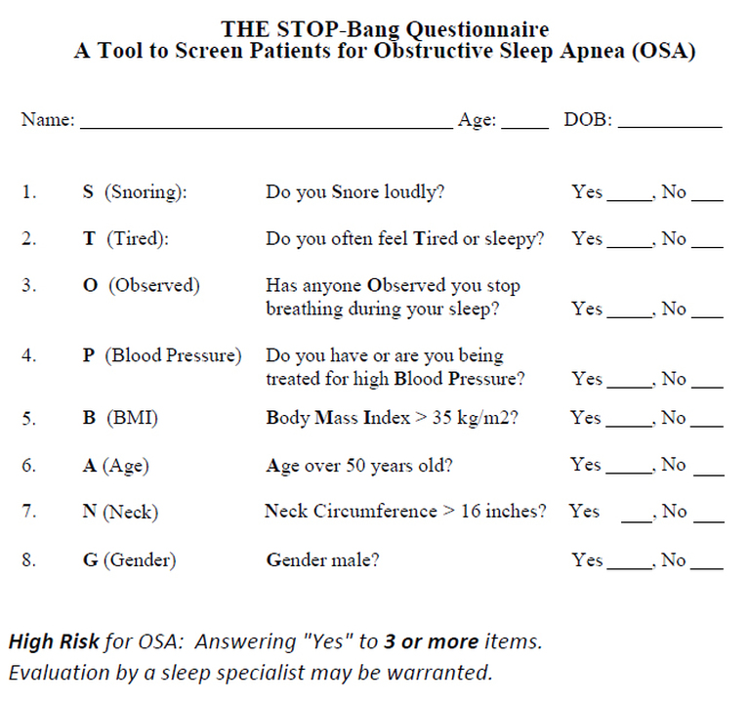
STOP-BANG Questionnaire
Chung F et al. Anesthesiology. 2008 May;108(5):812-21
Notes:
STOP questionnaire: a tool to screen patients for obstructive sleep apnea.
Chung F, Yegneswaran B, Liao P, Chung SA, Vairavanathan S, Islam S, Khajehdehi A, Shapiro CM.
Source
Department of Psychiatry, University of Toronto, Toronto Western Hospital, University Health Network, Toronto, Ontario, Canada. frances.chung@uhn.on.ca
Abstract
BACKGROUND:
Obstructive sleep apnea (OSA) is a major risk factor for perioperative adverse events. However, no screening tool for OSA has been validated in surgical patients. This study was conducted to develop and validate a concise and easy-to-use questionnaire for OSA screening in surgical patients.
METHODS:
After hospital ethics approval, preoperative patients aged 18 yr or older and without previously diagnosed OSA were recruited. After a factor analysis, reliability check, and pilot study; four yes/no questions were used to develop this screening tool. The four questions were respectively related to snoring, tiredness during daytime, observed apnea, and high blood pressure (STOP). For validation, the score from the STOP questionnaire was evaluated versus the apnea-hypopnea index from monitored polysomnography.
RESULTS:
The STOP questionnaire was given to 2,467 patients, 27.5% classified as being at high risk of OSA. Two hundred eleven patients underwent polysomnography, 34 for the pilot test and 177 for validation. In the validation group, the apnea-hypopnea index was 20 +/- 6. The sensitivities of the STOP questionnaire with apnea-hypopnea index greater than 5, greater than 15, and greater than 30 as cutoffs were 65.6, 74.3, and 79.5%, respectively. When incorporating body mass index, age, neck circumference, and gender into the STOP questionnaire, sensitivities were increased to 83.6, 92.9, and 100% with the same apnea-hypopnea index cutoffs.
CONCLUSIONS:
The STOP questionnaire is a concise and easy-to-use screening tool for OSA. It has been developed and validated in surgical patients at preoperative clinics. Combined with body mass index, age, neck size, and gender, it had a high sensitivity, especially for patients with moderate to severe OSA.

Slide 40
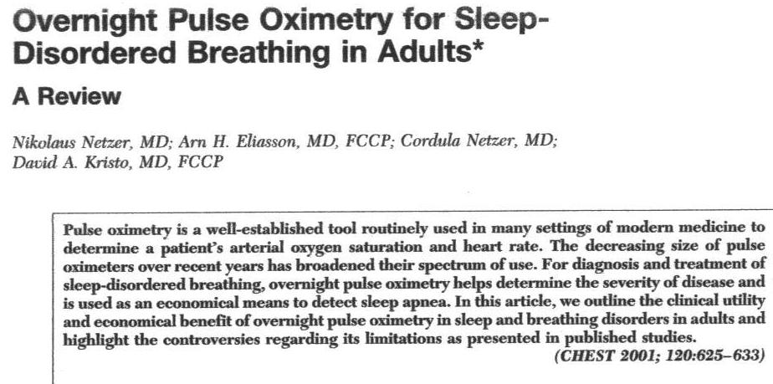
Pulse oximetry as a screening tool
CHEST. 2001;120:625-633.

Slide 41
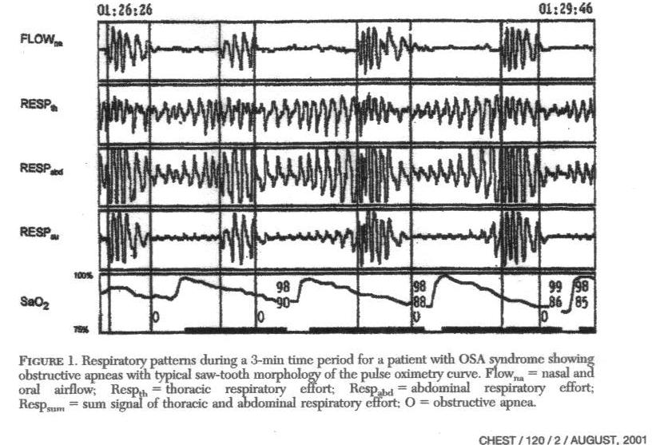
CHEST. 2001;120:625-633.
Notes:
saw-tooth pattern on oxygen desaturation waveforms (waveform derived as a plot of Sao2 vs time)
typical cyclical drop in Sao2 in patients with OSA lags 45-60 s behind a respiratory event

Slide 42
Pulse oximetry as a screening tool
Sensitivity ranges 31-98%
Specificity 41-100%
Cooper et al (1991)
  Sensitivity and specificity of pulse oximetry for identifying OSA was dependent on the AHI
    AHI ≥ 25 the sensitivity was 100% and the specificity 95%
    AHI ≥ 15, 75% and 86%
    AHI ≥ 5, 60% and 80%
Pulse oximetry is an effective tool for screening patients with moderate-to-severe sleep apnea
CHEST. 2001;120:625-633.
Notes:
Pulse oximetry
Sensitivity ranges 31-98%
Specificity 41-100%
Cooper et al

Slide 43
Limitations to pulse oximetry
Poor peripheral arterial blood flow (PVD, hypotension)
Body movements
Anemia (overestimation of respiratory-caused desaturations)
Tissue optics in very obese patients
Not good at detecting CSA or UARS
S/S dependent on degree of OSA
Notes:
Take home message: It’s a good SCREENING tool, not a great DIAGNOSTIC tool!

Slide 44
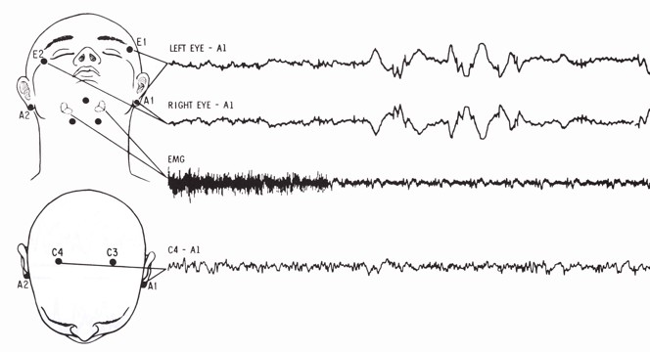
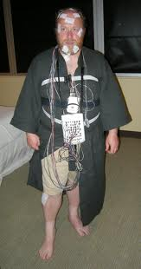
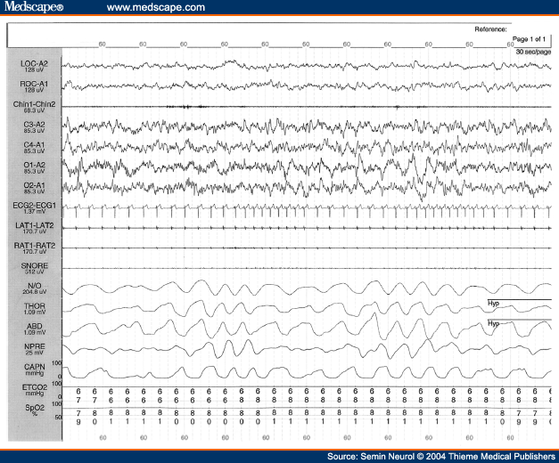
Gold Standard = PSG
Notes:
Thermistors and nasal pressure transducers

Slide 45
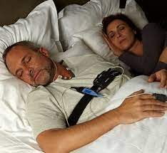
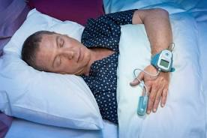
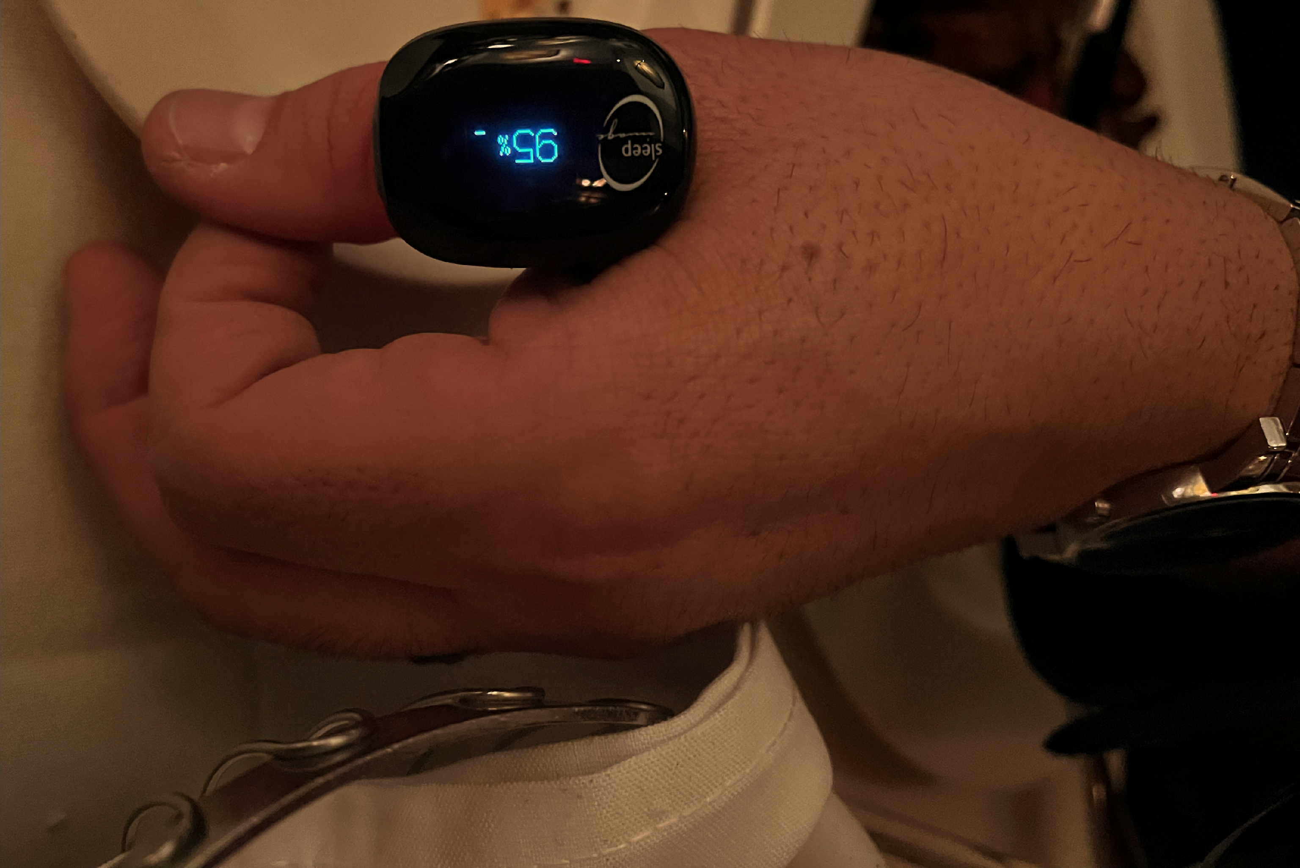
Home Sleep Study Devices
Notes:
Sleep image new device

Slide 46
Alternative technology for diagnosing OSA in the stroke unit
Vayrynen et al (Finland)
  Feasibility study using a limited ambulatory recording system (sleep mattress)
    Emfit movement sensor placed under thoracic area to assess effort
    pulse oximetry
    single EKG
    EOG leads to estimate TST
  42 patients with mild stroke (NIHSS <12) or TIA
  OSA found in 22 (52.4%), CSA in 2 (4.8%) with close correlation compared to in-lab PSG
Vayrynen et al. Sleep Disorders 2014; Epub 2014, May 27

Slide 47
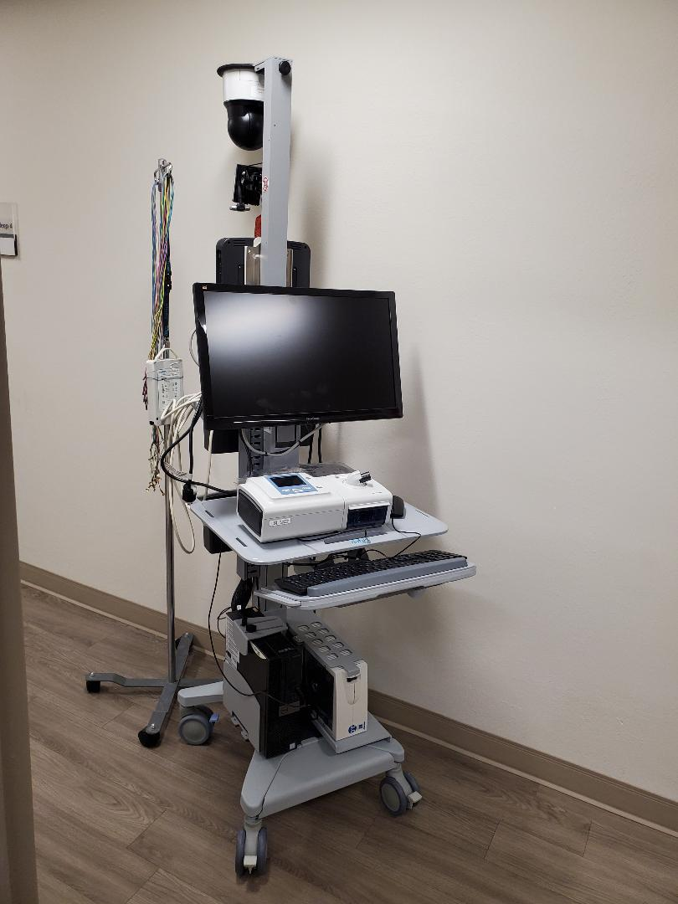
International Stroke Conference Moderated Poster Abstracts, 2020
The Portable Sleep Study as an Early Obstructive Sleep Apnea Screening Tool In Acute Ischemic Stroke
OLEG Y CHERNYSHEV¹; Douglas E Moul²; Cesar Liendo³; David E McCarty³; Gloria Caldito³; Sai K Munjampalli³; Roger Kelley⁴; Andrew Chesson⁵
Background: Prompt diagnosis of obstructive sleep apnea (OSA) after acute ischemic stroke (AIS) is critical for optimal clinical outcomes, but full bedside polysomnograms are not routinely practical.
Methods: Simultaneous bedside Level 3 (Embletta X100) PSS and PSG studies were performed in patients <72 hours from stroke onset. The accuracy of PSS was compared to PSG using: Chi-square tests, Receiver-Operatory Characteristic curves, Bland-Altman plot, paired Student t-test /Wilcoxon signed rank test and calculation of sensitivity, specificity, positive predictive value (PPV), negative predictive value (NPV).
Results: Twenty one out of 23 acute ischemic stroke patients (age 61+ 9.4; 52% male; 58% African-American), successfully completed both of the simultaneous screenings (9% technical failure). Ten AIS patients (48%) were diagnosed with OSA. Nearly all (90%) had Mallampati IV posterior oropharynx; the mean neck circumference was 17.3± 1.3 inches; the mean BMI was 35.1 ±5 kg/m². The Apnea Hypopnea Index (AHI) provided by PSS was similar to that provided by PSG (29.1± 16.8 vs. 27.6 + 20.2, respectively; p=0.10). In identifying patients with AHI >5 on PSG, PSS screening had the following parameters: sensitivity 100%; specificity 85.7%; PPV 91%; NPV 100%. For AHI >15 on PSG, PSS screening parameters were as follows: Sensitivity 100%; Specificity 83.3%; PPV 71.4%; NPV 100%. Bland-Altman plotting showed overall diagnostic agreement between PSS and PSG modalities for an AHI cutoff of > 5, despite finer-grained differences in estimated AHIs.
Conclusions: Compared with PSG, PSS provides similar diagnostic information when run simultaneously in acute ischemic stroke patients. PSS potentially can serve as a reliable screening tool for early diagnosis of obstructive sleep apnea in acute ischemic stroke patients.
Notes:
But no head to head trials to look for superiority of devices!!!!
Author Disclosures: O.Y. Chernyshev: Research Grant; Significant; 1. American Sleep Medicine Foundation Grant #58-PA-10. American Academy of Sleep Medicine’s 2010 Physician Scientist Training Award in the Best Science category, 2. Cardiovascular Institute Grant, Louisiana State University Health Sciences Center, Shreveport, LA. D.E. Moul: None. C. Liendo: None. D.E. McCarty: None. G. Caldito: None. S.K. Munjampalli: None. R. Kelley: None. A. Chesson: None.
International Stroke Conference Moderated Poster Abstracts, 2013
Diagnosis Moderated Poster Tour I
Abstract WMP58: The Portable Sleep Study as an Early Obstructive Sleep Apnea Screening Tool In Acute Ischemic Stroke
OLEG Y CHERNYSHEV¹; Douglas E Moul²; Cesar Liendo³; David E McCarty³; Gloria Caldito³; Sai K Munjampalli³; Roger Kelley⁴; Andrew Chesson⁵
¹ Univ of Texas Med Sch -Houston, Houston, TX ² Cleveland Clinic, Cleveland, OH ³ Louisiana State Univ Health Sciences Cntr- Shreveport, Shreveport, LA ⁴ Tulane Univ, New Orleans, LA ⁵ Louisiana State Univ Health Sciences Cntr, Shreveport, LA
Background: Prompt diagnosis of obstructive sleep apnea (OSA) after acute ischemic stroke (AIS) is critical for optimal clinical outcomes, but full bedside polysomnograms are not routinely practical. To validate a potentially practical diagnostic portable cardiopulmonary sleep study (PSS) after such strokes, we compared it to conventional polysomnography (PSG).
Methods: Simultaneous bedside Level 3 (Embletta X100) PSS and PSG studies were performed in patients <72 hours from stroke onset. The accuracy of PSS was compared to PSG using: Chi-square tests, Receiver-Operatory Characteristic curves, Bland-Altman plot, paired Student t-test /Wilcoxon signed rank test and calculation of sensitivity, specificity, positive predictive value (PPV), negative predictive value (NPV).
Results: Twenty one out of 23 acute ischemic stroke patients (age 61+ 9.4; 52% male; 58% African-American), successfully completed both of the simultaneous screenings (9% technical failure). Ten AIS patients (48%) were diagnosed with OSA. Nearly all (90%) had Mallampati IV posterior oropharynx; the mean neck circumference was 17.3± 1.3 inches; the mean BMI was 35.1 ±5 kg/m². The Apnea Hypopnea Index (AHI) provided by PSS was similar to that provided by PSG (29.1± 16.8 vs. 27.6 + 20.2, respectively; p=0.10). In identifying patients with AHI 5 on PSG, PSS screening had the following parameters: sensitivity 100%; specificity 85.7%; PPV 91%; NPV 100%. For AHI 15 on PSG, PSS screening parameters were as follows: Sensitivity 100%; Specificity 83.3%; PPV 71.4%; NPV 100%. Bland-Altman plotting showed overall diagnostic agreement between PSS and PSG modalities for an AHI cutoff of > 5, despite finer-grained differences in estimated AHIs.
Conclusions: Compared with PSG, PSS provides similar diagnostic information when run simultaneously in acute ischemic stroke patients. PSS potentially can serve as a reliable screening tool for early diagnosis of obstructive sleep apnea in acute ischemic stroke patients.

Slide 48

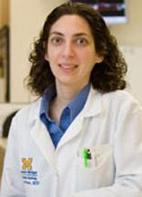

SLEEP SMART TRIAL
Sleep for Stroke Management and Recovery Trial
Primary goals: To determine whether treatment of OSA with PAP starting shortly after acute ischemic stroke or high risk TIA
  (1) reduces recurrent stroke, acute coronary syndrome, and all-cause mortality during 6 months after the event
  (2) improves stroke outcomes at 3 months in patients who experienced an ischemic stroke

Slide 49
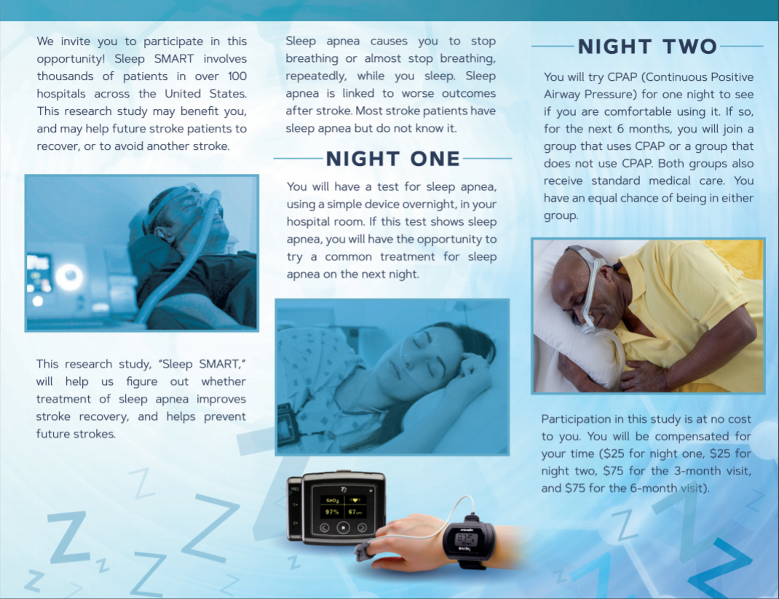
SLEEP SMART TRIAL

Slide 50
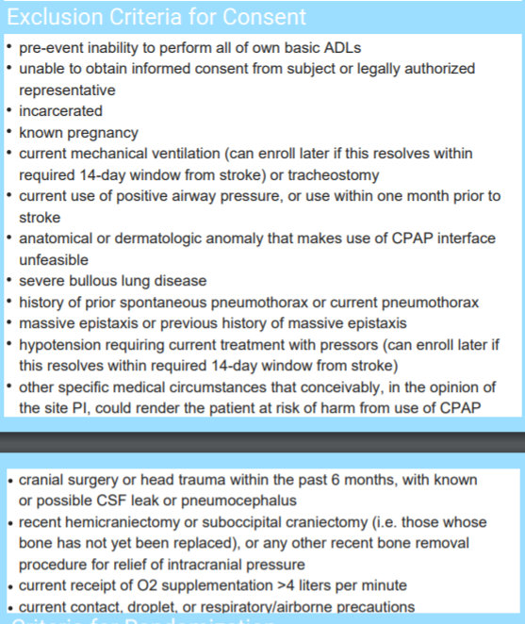
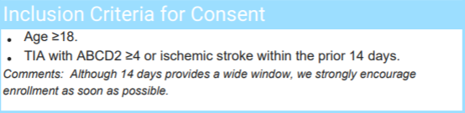

Slide 51
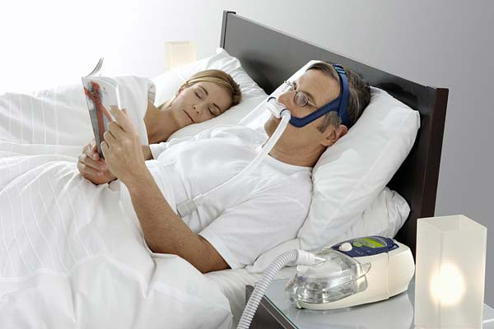
CPAP or Bilevel PAP devices:
role in stroke prevention

Slide 52
Use of CPAP to reduce stroke risk
Reduces arterial blood pressure
    -CPAP reduced MAP by 2.5 mm Hg, with an associated stroke risk reduction of 20%
    Pepperell et al, Lancet 2001;359:204-210
Improves blood flow to the brain
CPAP therapy reduces mortality, especially after stroke

Slide 53
CPAP Treatment in Sleep Apnea Prevents New Vascular Events After Ischemic Stroke
Martinez-Garcia et al.
Prospective study
95 Stroke pts identified
  Two groups: CPAP tolerant (29.4%) versus intolerant
The incidence of new vascular events for 18 months
    New VE in tolerant and non-tolerant was 6.7% and 36%, respectively (p = 0.03).
    1 stroke (6.7%) in group 1 and seven strokes (19.4%) in group 2.
    Intolerance of CPAP increased the probability of a new vascular event fivefold (odds ratio, 5.09) adjusted for other vascular risk factors.
CHEST. 2005;128 (4): 2123-2129.
Notes:
Figure 1 shows the Kaplan-Meier survival curves corresponding to the groups studied. Fourteen new VEs were identified in the course of the study (11 ischemic strokes, 1 episode of angina, and 2 acute myocardial infarctions). The incidence of new VE in groups 1 and 2 was 6.7% and 36%, respectively (p = 0.03). Of these events, one stroke (6.7%) in group 1 and seven strokes (19.4%) in group 2 occurred in patients with AF.

Slide 54
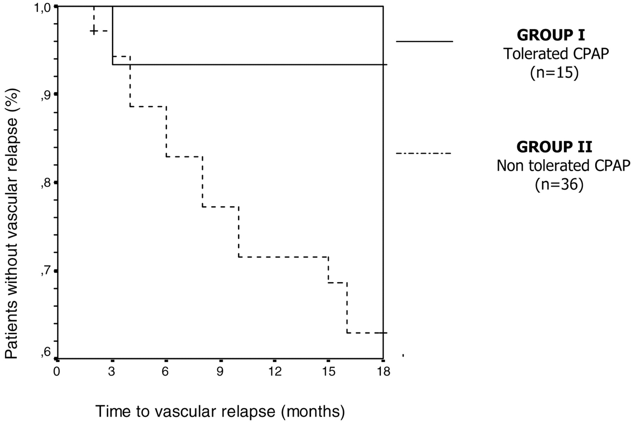

Kaplan-Meier survival curves for assessing the recurrence of VEs in the patient groups conformed according to CPAP tolerance.
Martínez-García M Á et al. Chest 2005;128:2123-2129
Notes:
Kaplan-Meier survival curves for assessing the recurrence of VEs in the patient groups conformed according to CPAP tolerance. Log-rank test (p = 0.03) between groups 1 and 2 adjusted for the presence of AF.

Slide 55
CPAP Study
5 year follow study from Spain
166 pts
CPAP treatment offered to pts with AHI > 20
5 year mortality evaluated
Conclusion: CPAP independently decreased mortality
Martinez-Garcia et al, Am J respir Crit Care med, 2009; 180: 36-41.
Notes:
Observational prospective study
The impact of long-term CPAP treatment on mortality in patients with acute stroke diagnosed with OSA during overnight PSG was evaluated in a 5 year prospective observational study. It revealed that patients with an AHI of >20 or greater who did not tolerate CPAP (n=69) showed an increased adjusted risk of mortality (HR 2.69;1.32, 5.61 CI) as compared with pts with an AHI of <20 (n=70) and an increased adjusted risk of mortality (HR 1.58;1.01, 2.49 CI, p=0.04) compared with pts with moderate-severe OSA who tolerated CPAP.
There was no diff in mortality among pts without Osa, pts with mild disease, and pts who tolerated CPAP.
This study suggested that long-term CPAP treatment in stroke pts with moderate-severe OSA is associated with a reduction in excess mortality.

Slide 56
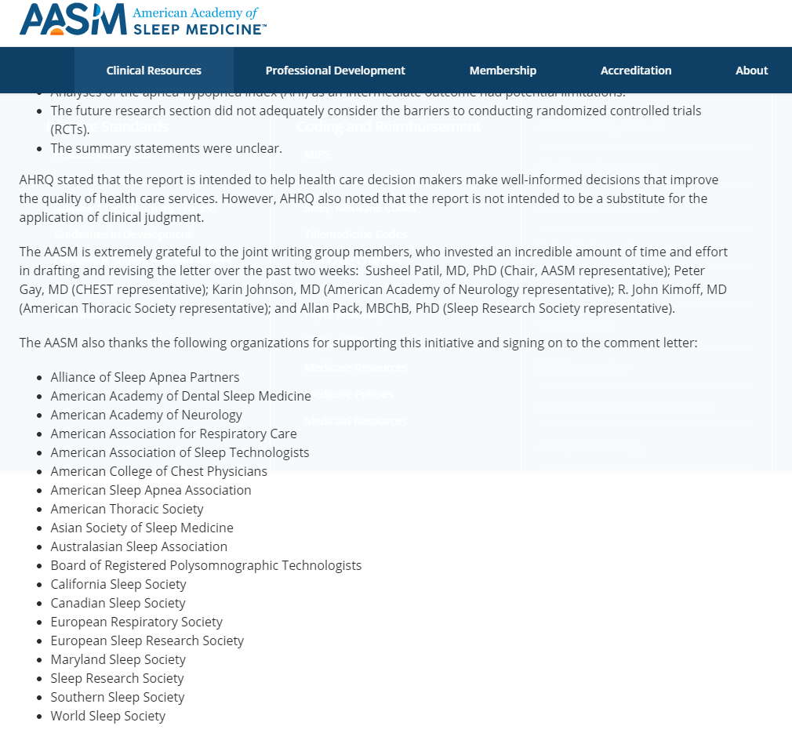

Slide 57
Does CPAP Prevent Stroke & Death?
Stroke. 2021;52(1):366-372
Slides used wtih permission from M.Boulos

Slide 58
Effect of CPAP after Stroke: RCTs
1st Author, Year | N | Inclusion Criteria | Timing of Intervention Post-stroke | Follow-up period(s) | CPAP adherence (hrs/night) | Main outcome(s)
Sandberg, 2001 | 63 | AHI ≥15 | 2-4 weeks | 7 & 28 days | 4.1 | ↓ depression
Hsu, 2006 | 66 | AHI ≥30 NIHSS ≥4 | 21-25 days | 8 weeks & 6 months | 1.4 | No difference
Parra, 2011 Parra, 2015 | 140 | AHI ≥20 | 3-6 days | 1, 3, 12, 24 months 5 years | 5.3 | No difference ↓ cardiovascular-related deaths
Ryan, 2011 | 44 | AHI ≥15 | Within 3 weeks | 1 month | 4.96 | ↑ functional & motor outcomes
Bravata, 2011 | 55 | AHI ≥5 NIHSS ≥2 | Most within 48 hrs | 1 month | 5.1 | ↓ NIHSS
Minnerup, 2012 | 50 | AHI ≥10 NIHSS 2-20 | First night | 8 days | 4.2 | ↓ AHI ↓ NIHSS with CPAP compliance
McEvoy, 2016 | 2717 (1324 stroke) | Oxygen desaturation index ≥12 | ≥90 days | 6 months, 2 and 4 years | 3.3 | ↓ snoring & daytime sleepiness ↑ quality of life & mood No impact on vascular events
Aaronson, 2016 | 36 | AHI ≥15 | 1-16 weeks | 4 weeks | 2.5 | ↑ attention & executive function
Khot, 2016 | 40 | AHI ≥5 | During time in stroke rehab unit | 2-3 weeks | 3.7 | No difference
Gupta, 2018 | 70 | AHI ≥15 | <6 months | 3, 6, 12 months | 4.2 | ↓ mRS & daytime sleepiness No impact on vascular events
Bravata, 2018 | 252 | AHI ≥5 | Within 1 week | 6, 12 months | 4.5 | ↓ NIHSS & mRS with CPAP compliance

Slide 59
Effect of CPAP after Stroke: RCTs
1st Author, Year | N | Inclusion Criteria | Timing of Intervention Post-stroke | Follow-up period(s) | CPAP adherence (hrs/night) | Main outcome(s)
Sandberg, 2001 | 63 | AHI ≥15 | 2-4 weeks | 7 & 28 days | 4.1 | ↓ depression
Hsu, 2006 | 66 | AHI ≥30 NIHSS ≥4 | 21-25 days | 8 weeks & 6 months | 1.4 | No difference
Parra, 2011 Parra, 2015 | 140 | AHI ≥20 | 3-6 days | 1, 3, 12, 24 months 5 years | 5.3 | No difference ↓ cardiovascular-related deaths
Ryan, 2011 | 44 | AHI ≥15 | Within 3 weeks | 1 month | 4.96 | ↑ functional & motor outcomes
Bravata, 2011 | 55 | AHI ≥5 NIHSS ≥2 | Most within 48 hrs | 1 month | 5.1 | ↓ NIHSS
Minnerup, 2012 | 50 | AHI ≥10 NIHSS 2-20 | First night | 8 days | 4.2 | ↓ AHI ↓ NIHSS with CPAP compliance
McEvoy, 2016 | 2717 (1324 stroke) | Oxygen desaturation index ≥12 | ≥90 days | 6 months, 2 and 4 years | 3.3 | ↓ snoring & daytime sleepiness ↑ quality of life & mood No impact on vascular events
Aaronson, 2016 | 36 | AHI ≥15 | 1-16 weeks | 4 weeks | 2.5 | ↑ attention & executive function
Khot, 2016 | 40 | AHI ≥5 | During time in stroke rehab unit | 2-3 weeks | 3.7 | No difference
Gupta, 2018 | 70 | AHI ≥15 | <6 months | 3, 6, 12 months | 4.2 | ↓ mRS & daytime sleepiness No impact on vascular events
Bravata, 2018 | 252 | AHI ≥5 | Within 1 week | 6, 12 months | 4.5 | ↓ NIHSS & mRS with CPAP compliance
Improved non-vascular outcomes

Slide 60
Effect of CPAP after Stroke: RCTs
1st Author, Year | N | Inclusion Criteria | Timing of Intervention Post-stroke | Follow-up period(s) | CPAP adherence (hrs/night) | Main outcome(s)
Sandberg, 2001 | 63 | AHI ≥15 | 2-4 weeks | 7 & 28 days | 4.1 | ↓ depression
Hsu, 2006 | 66 | AHI ≥30 NIHSS ≥4 | 21-25 days | 8 weeks & 6 months | 1.4 | No difference
Parra, 2011 Parra, 2015 | 140 | AHI ≥20 | 3-6 days | 1, 3, 12, 24 months 5 years | 5.3 | No difference ↓ cardiovascular-related deaths
Ryan, 2011 | 44 | AHI ≥15 | Within 3 weeks | 1 month | 4.96 | ↑ functional & motor outcomes
Bravata, 2011 | 55 | AHI ≥5 NIHSS ≥2 | Most within 48 hrs | 1 month | 5.1 | ↓ NIHSS No impact on vascular events
Minnerup, 2012 | 50 | AHI ≥10 NIHSS 2-20 | First night | 8 days | 4.2 | ↓ AHI ↓ NIHSS with CPAP compliance
McEvoy, 2016 | 2717 (1324 stroke) | Oxygen desaturation index ≥12 | ≥90 days | 6 months, 2 and 4 years | 3.3 | ↓ snoring & daytime sleepiness ↑ quality of life & mood No impact on vascular events
Aaronson, 2016 | 36 | AHI ≥15 | 1-16 weeks | 4 weeks | 2.5 | ↑ attention & executive function
Khot, 2016 | 40 | AHI ≥5 | During time in stroke rehab unit | 2-3 weeks | 3.7 | No difference
Gupta, 2018 | 70 | AHI ≥15 | <6 months | 3, 6, 12 months | 4.2 | ↓ mRS & daytime sleepiness No impact on vascular events
Bravata, 2018 | 252 | AHI ≥5 | Within 1 week | 6, 12 months | 4.5 | ↓ NIHSS & mRS with CPAP compliance
No difference in
vascular outcomes

Slide 61
Effect of CPAP after Stroke: RCTs
1st Author, Year | N | Inclusion Criteria | Timing of Intervention Post-stroke | Follow-up period(s) | CPAP adherence (hrs/night) | Main outcome(s)
Sandberg, 2001 | 63 | AHI ≥15 | 2-4 weeks | 7 & 28 days | 4.1 | ↓ depression
Hsu, 2006 | 66 | AHI ≥30 NIHSS ≥4 | 21-25 days | 8 weeks & 6 months | 1.4 | No difference
Parra, 2011 Parra, 2015 | 140 | AHI ≥20 | 3-6 days | 1, 3, 12, 24 months 5 years | 5.3 | No difference ↓ cardiovascular-related deaths
Ryan, 2011 | 44 | AHI ≥15 | Within 3 weeks | 1 month | 4.96 | ↑ functional & motor outcomes
Bravata, 2011 | 55 | AHI ≥5 NIHSS ≥2 | Most within 48 hrs | 1 month | 5.1 | ↓ NIHSS No impact on vascular events
Minnerup, 2012 | 50 | AHI ≥10 NIHSS 2-20 | First night | 8 days | 4.2 | ↓ AHI ↓ NIHSS with CPAP compliance
McEvoy, 2016 | 2717 (1324 stroke) | Oxygen desaturation index ≥12 | ≥90 days | 6 months, 2 and 4 years | 3.3 | ↓ snoring & daytime sleepiness ↑ quality of life & mood No impact on vascular events
Aaronson, 2016 | 36 | AHI ≥15 | 1-16 weeks | 4 weeks | 2.5 | ↑ attention & executive function
Khot, 2016 | 40 | AHI ≥5 | During time in stroke rehab unit | 2-3 weeks | 3.7 | No difference
Gupta, 2018 | 70 | AHI ≥15 | <6 months | 3, 6, 12 months | 4.2 | ↓ mRS & daytime sleepiness No impact on vascular events
Bravata, 2018 | 252 | AHI ≥5 | Within 1 week | 6, 12 months | 4.5 | ↓ NIHSS & mRS with CPAP compliance
Small sample sizes

Slide 62
Effect of CPAP after Stroke: RCTs
1st Author, Year | N | Inclusion Criteria | Timing of Intervention Post-stroke | Follow-up period(s) | CPAP adherence (hrs/night) | Main outcome(s)
Sandberg, 2001 | 63 | AHI ≥15 | 2-4 weeks | 7 & 28 days | 4.1 | ↓ depression
Hsu, 2006 | 66 | AHI ≥30 NIHSS ≥4 | 21-25 days | 8 weeks & 6 months | 1.4 | No difference
Parra, 2011 Parra, 2015 | 140 | AHI ≥20 | 3-6 days | 1, 3, 12, 24 months 5 years | 5.3 | No difference ↓ cardiovascular-related deaths
Ryan, 2011 | 44 | AHI ≥15 | Within 3 weeks | 1 month | 4.96 | ↑ functional & motor outcomes
Bravata, 2011 | 55 | AHI ≥5 NIHSS ≥2 | Most within 48 hrs | 1 month | 5.1 | No impact on vascular events … but a trend was seen
Minnerup, 2012 | 50 | AHI ≥10 NIHSS 2-20 | First night | 8 days | 4.2 | ↓ AHI ↓ NIHSS with CPAP compliance
McEvoy, 2016 | 2717 (1324 stroke) | Oxygen desaturation index ≥12 | ≥90 days | 6 months, 2 and 4 years | 3.3 | ↓ snoring & daytime sleepiness ↑ quality of life & mood No impact on vascular events
Aaronson, 2016 | 36 | AHI ≥15 | 1-16 weeks | 4 weeks | 2.5 | ↑ attention & executive function
Khot, 2016 | 40 | AHI ≥5 | During time in stroke rehab unit | 2-3 weeks | 3.7 | No difference
Gupta, 2018 | 70 | AHI ≥15 | <6 months | 3, 6, 12 months | 4.2 | ↓ mRS & daytime sleepiness No impact on vascular events
Bravata, 2018 | 252 | AHI ≥5 | Within 1 week | 6, 12 months | 4.5 | ↓ NIHSS & mRS with CPAP compliance
Intervening too late?

Slide 63
Effect of CPAP after Stroke: RCTs
1st Author, Year | N | Inclusion Criteria | Timing of Intervention Post-stroke | Follow-up period(s) | CPAP adherence (hrs/night) | Main outcome(s)
Sandberg, 2001 | 63 | AHI ≥15 | 2-4 weeks | 7 & 28 days | 4.1 | ↓ depression
Hsu, 2006 | 66 | AHI ≥30 NIHSS ≥4 | 21-25 days | 8 weeks & 6 months | 1.4 | No difference in neurological recovery or sleepiness
Parra, 2011 Parra, 2015 | 140 | AHI ≥20 | 3-6 days | 1, 3, 12, 24 months 5 years | 5.3 | No difference ↓ cardiovascular-related deaths
Ryan, 2011 | 44 | AHI ≥15 | Within 3 weeks | 1 month | 4.96 | ↑ functional & motor outcomes
Bravata, 2011 | 55 | AHI ≥5 NIHSS ≥2 | Most within 48 hrs | 1 month | 5.1 | ↓ NIHSS
Minnerup, 2012 | 50 | AHI ≥10 NIHSS 2-20 | First night | 8 days | 4.2 | ↓ AHI ↓ NIHSS with CPAP compliance
McEvoy, 2016 | 2717 (1324 stroke) | Oxygen desaturation index ≥12 | ≥90 days | 6 months, 2 and 4 years | 3.3 | ↓ snoring & daytime sleepiness ↑ quality of life & mood No impact on vascular events
Aaronson, 2016 | 36 | AHI ≥15 | 1-16 weeks | 4 weeks | 2.5 | ↑ attention & executive function
Khot, 2016 | 40 | AHI ≥5 | During time in stroke rehab unit | 2-3 weeks | 3.7 | No difference in recovery
Gupta, 2018 | 70 | AHI ≥15 | <6 months | 3, 6, 12 months | 4.2 | ↓ mRS & daytime sleepiness No impact on vascular events
Bravata, 2018 | 252 | AHI ≥5 | Within 1 week | 6, 12 months | 4.5 | ↓ NIHSS & mRS with CPAP compliance
↓ CPAP Adherence
= Negative Study

Slide 64
The SAVE trial: Sleep Apnea Cardiovascular Endpoints
No difference in stroke incidence in CPAP + usual care vs usual care alone
Excluded patients with:
  Severe daytime sleepiness (ESS >15)
  Severe hypoxemia (oxygen satuation <80% or for >10% of the recording time)
Excluded patients who likely would have most benefited from study intervention
Boulos et al. Stroke 2021;52(1):366-372.
N Engl J Med. 2016;375(10):919-31
Notes:
The Sleep Apnea Cardiovascular Endpoints (SAVE) study in 2016 investigated stroke incidence in 2717 participants aged 45-75 years who had moderate-to-severe sleep apnea and cardiovascular or cerebrovascular disease. Half of the subjects were randomized to receive CPAP plus usual care, while the other half were assigned to usual care alone. With a mean follow-up period of 3.7 years, no difference in stroke incidence was seen between the two groups. However, it is important to note that only 42% of the CPAP participants were considered compliant with therapy (minimum of 4h of CPAP use per night) with a mean overall adherence of 3.3h a night. Additionally, the population studied were mostly of Asian descent and excluded patients with excessive daytime sleepiness, the group most likely to benefit from intervention. Ultimately, the design of the study did not sufficiently address the role of CPAP therapy in stroke prevention. However, it is important to note that secondary end points of reduced daytime hypersomnolence, reduced anxiety and depression, and overall improvement in quality of life measures were seen in the treatment arm (26).

Slide 65
Pre-planned one-to-one propensity score matching was used to match CPAP compliers (use of CPAP ≥4hrs/night) to patients from the control arm who would have complied
Suggested reduction in stroke events with good CPAP adherence
N Engl J Med. 2016;375(10):919-31
Boulos et al. Stroke 2021;52(1):366-372.

Slide 66
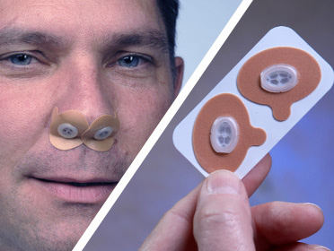
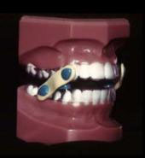
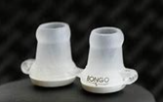
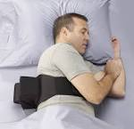
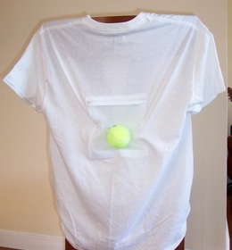
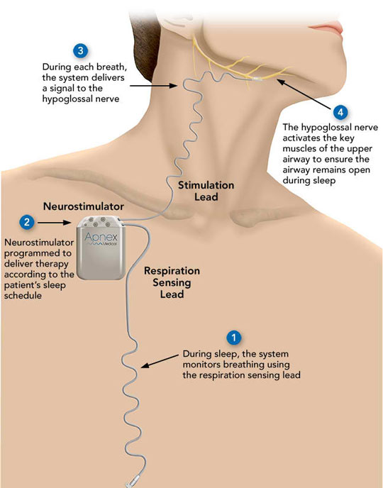
Alternative treatment of OSA
Nasal expiratory PAP
Positional therapy
Oral appliances
Hypoglossal nerve stimulator
Medications
Notes:
A device to stimulate a nerve at the base of the tongue substantially improved sleep apnea in patients who couldn't tolerate standard continuous positive airway pressure (CPAP) treatment, a trial showed.
Upper airway pacing of the hypoglossal nerve, coordinated with breathing via a sensing lead in the chest, reduced the apnea-hypopnea index by 68%, from a median 29.3 events per hour before implantation to nine after 1 year of use (P<0.001), Patrick J. Strollo Jr., MD, of the University of Pittsburgh Medical Center, and colleagues found.
The oxygen desaturation index score likewise fell 70%, from 25.4 events per hour to 7.4 events per hour (P<0.001), the group reported in the Jan. 9 issue of the New England Journal of Medicine.
Daytime sleepiness and quality of life both improved as well in their uncontrolled, open-label STAR (Stimulation Therapy for Apnea Reduction) trial.
"This technology really provides an option for patients who otherwise cannot be treated," Strollo told MedPage Today, pointing to the considerable risk for cardiovascular complications and death if left untreated.
But the pacemaker-style device from Inspire Medical Systems won't replace CPAP as the first-line therapy for obstructive sleep apnea, Strollo cautioned in an interview.
"The gold standard is still positive pressure via mask," he said.
The implantation procedure did carry risks (serious complications in less than 2%) and some patients couldn't tolerate the feeling of the involuntary movement of their tongue when the stimulation was turned on at night via a magnet.
Also, the procedure wasn't an option for most patients, Joseph Kaplan, MD, director of the Mayo Clinic Sleep Center in Jacksonville, Fla., pointed out in an interview.
After recruiting 929 patients, all but 126 were excluded for being obese (32 kg/m² or above) or having anatomic or sleep apnea characteristics not considered suitable on endoscopy during propofol-induced anesthesia to determine the nature of pharyngeal collapse.
Another concern is that "no one really knows the long-term complications or benefits of stimulating the hypoglossal nerve," Kaplan added.
Although chronic damage to the tongue wasn't observed during the 12 month study, further study would be needed to monitor that and to confirm that the cardiovascular protection expected from CPAP carries over to this therapy and that the nerve doesn't fatigue as has been the case with phrenic nerve stimulation, he explained.
Also, the study lacked blinding or a real control group, Atul Malhotra, MD, of the University of California, San Diego, noted in an accompanying editorial.
"Diet, exercise, or other unmeasured factors may have changed during the course of the study and could have contributed to the observed reduction in obstructive sleep apnea," he wrote. "Indeed, a competing trial failed to show a between-group difference in the reduction of sleep apnea, owing to major unanticipated improvements in the control group."
For that upper airway pacing device by now-defunct Apnex Medical, the trial waited 6 months after implantation to turn on pacing, during which time patients may have re-evaluated their lifestyle choices, explained STAR study senior author Kingman P. Strohl, MD.
Other differences that might have accounted for the failure of that trial were the higher body mass index cutoff for inclusion (35 versus 32 kg/m2 in STAR) and its use of impedance instead of a pressure sensor to trigger nerve stimulation at the right time during respiration, added Strohl, director of sleep medicine at University Hospitals Case Medical Center in Cleveland.
"However, the results of the randomized, therapy-withdrawal trial provide reassurance that the benefits from hypoglossal-nerve stimulation observed by Strollo et al. were real," Malhotra acknowledged.
The 46 patients with at least a 50% reduction in apnea-hypopnea score to less than 20 events per hour were randomized after 12 months to stop therapy with Inspire Medical Systems' device for a week or continue it.
The results showed that events roughly returned to baseline without the treatment (25.8 versus 7.6 events per hour, P<0.001), which supported the impact of therapy but not a remodeling effect of nerve stimulation.
"There is a role for this kind of therapy," Kaplan concluded, agreeing with Malhotra's call for future more definitive randomized, controlled trials focused on hard outcomes.
Another clinical trial is underway with a third hypoglossal stimulation device.
The study was funded by Inspire Medical Systems.

Slide 67
Summary
OSA is an independent risk factor for stroke
Validated questionnaires (ESS, STOP-BANG) are simple, effective screening tools to identify OSA pts
PSG is the gold standard for diagnosing OSA but home sleep studies are now more widely used as first line-screening
Treatment of OSA with CPAP reduces the risk of recurrent stroke and death (but future studies needed)
There are alternative therapies available

Slide 68
References
Young T, Finn Laurel, Peppard P, Szklo-Coxe M, Austin D, Nieto F, Stubbs R, Hia K. Sleep-disordered breathing and Mortality: eighteen year follow-up of the Wisconsin sleep cohort. Sleep 2008; 31 (8):1071-1078
Shamsuzzaman A, Gersh BJ, Somers VK. Obstructive Sleep Apnea: Implications for Cardiac and Vascular disease. JAMA 2003; 290:1906-1914
Pack AI, Gislason T. Obstructive Sleep Apnea and cardiovascular Disease: A Perspective and Future directions. Progress in cardiovascular diseases;51:434-451.
Munoz R, Duran-Cantolla J, Martinez-Vila E et al. Severe sleep apnea and risk of Ischemic stroke in the elderly. Stroke 2006;37:2317-2321.
Yaggi HK, Concato J, Kernan W. Obstructive sleep apnea as a risk factor for stroke and death. NEJM 2005; 353: 2034-2041.
Culebras Antonio. Sleep and Stroke. Seminars in Neurology/Volume 2009; 29: 438-445.
Somers VK, White DP, Amin R. Sleep Apnea and Cardiovascular. J AM Coll Cardiology 2008;52:686-717.
Portela PC, Fumado JC, Garcia HQ, Borrego FR. Sleep-disorder breathing and acute stroke. Cerebrovascular Disease 2009; 27: 104-110.
Martinez-Garcia MA, Soler-Cataluna JJ. Continuous Positive Airway Pressure Treatment reduces Mortality in patients with ischemic stroke and obstructive sleep apnea: A 5 year follow – up study. Am J respir Crit Care Med 2009; 180: 36-41.
Bonnin-Vilaplana M, Arboix A, Parra et al. Journal of Neurology 2009.
Butt, M, et al, Obstructive sleep apnea and cardiovascular disease, Int J Cardiol ( 2009).
Bassetti Claudio L, Milanova M, and Gugger M. Sleep- Disordered Breathing and Acute Ischemic Stroke: Diagnosis, Risk factors, Treatment, Evolution, and Long-term Clinical Outcome. Stroke 2006; 37: 967-972.

Slide 69
References
Minoguchi K, Yokeo T, Tazaki T, et al. Silent Brain infarction and platelet activation in obstructive sleep apnea. Am j Respir Crit Care Med. 2007;175:612-617.
Netzer N, Werner P et al, Blood flow of the middle cerebral artery with sleep disorder breathing: correlation with obstructive hypopneas. Stroke 1998;29(1): 87-93.
Cooper BG, Veale D, Griffiths CJ, et al. Value of nocturnal oxygen saturation as a screening test for sleep apnea. Thorax1991; 46:586–588.
Netzer N, Eliasson A et al. Overnight Pulse Oximetry for Sleep-Disordered Breathing in Adults. Chest 2001;120:625-633.
Rischer AQ, Chaudhary BA et al. Intracranial hemodynamics in sleep apnea. Chest 1992;102:1402-1406
Balfors EM, Franklin KA. Impairment of cerebral perfusion during obstructive sleep apnea. Am J Resp Crit Care Med 1994;150:1587-1591.
Wardlaw JM. Cheyne-Stokes respiration in patients with acute ischaemic stroke: observations on middle cerebral artery blood changes using transcranial doppler ultrasound. Cerebrovascular Dis 1993;3:377-380.
Silvestrini M, Rizzato B, et al. Carotid artery wall thickness in patients with obstructive sleep apnea syndrome. Stroke 2002;33:1782-1785.
Pepperell J, Ramdassingh-Dow S et al. Ambulatory blood pressure after therapeutic and subtherapeutic nasal continuous positive airway pressure for obstructive sleep apnea: A randomnized parallel trial. Lancet 2001;359:204-210.
Martínez-García M Á et al. Continuous Positive Airway Pressure Treatment in Sleep Apnea Prevents New Vascular Events After Ischemic Stroke. Chest 2005;128:2123-2129.
Peppared PE, Young T et al: Prospective study of the association between sleep-disordered breathing and hypertension. N Engl J Med 2000;342:1378-1384.

Slide 70
References
Bassetti C, Aldrich M, Chervin R et al: Sleep apnea in patients with transient ischemic attack and stroke: a prospective study of 59 patients. Neurology 1996;47:1167-1173.
Parra O, Arboix A, Bechich S, et al: time course for sleep-related breathing disorders in first-ever stroke or transient ischemic attack. AM J Respir Crit Care Med 2000;161:375-380.
Suzuki T, Nakano H, Maekawa J, et al. Obstructive sleep Apnea and Carotid-Artery Intima- Media Thickness. SLEEP 2004; 27: 129-133.
Tosun A, Kokturk O, Ciftci TU, Sepici V. Obstructive Sleep Apnea in Ischemic Stroke Patients. Clinics. 2008; 63; 625-630.
Arzt M, Young T, Finn L, Skatrud JB, Bradley TD. Association of sleep- disorded breathing and the occurrence of stroke. Am J Respir Crit care Med 2005; 172(11); 1447-1451.
Harbison J, Gibson G, Brichall D, et al: White matter disease and sleep-disordered breathing after acute stroke. Neurology 2003;61:959-963.
Guilleminault C, Pool P et al. Sinus arrest during REM sleep in young adults. N Engl J Med 1984;311(16):1006-1010.
Beelke M, Angeli S, Del Sette M, et al. Prevalence of patent foramen ovale in subjects with obstruction sleep apnea: a trancranial Doppler ultrasound study. Sleep Med 2003;4(3):219-223.
Peppared P, Young T, etal. Prospective Study of the association between sleep disordered breathing and hypertension. NEJM 2000;342(19):1378-1384.
Nieto FJ, Young TB, Lind BK, et al. Association of sleep-disordered breathing, sleep apnea, and hypertension in a large community-based study. Sleep Heart Health Study. JAMA 2000;283(14):1829-36.
CHEST. 2001;120:625-633.

Slide 71
References
Redline S, Yenokyan G, Gottlieb D, et al. Obstructive sleep apnea-hypopnea and incident stroke: the sleep heart health study. Am J Respir Crit Care Med. 2010;18(92):269-77.
Barone D, Krieger, A,. Stroke and Obstructive Sleep apne: A Review. Curr Atheroscler Rep. 2013;15(334):3-7.
Camilo M, Sander H, et al. SOS Score: an optimized score to screen acute stroke patients for obstructive sleep apnea. 2014;9: 1021-1024.
Szucs A, Vitrai J et al. Pathological sleep apnea frequency remains permanent in ischemic stroke and it is transient in hemorrhagic stroke. Eur Neurol 2002;47:15-19.
Sandberg O, Franklin K, et al. Nasal continuous positive airway pressure in stroke patients with sleep apnea: A randomized treatment study. Eur Respir J 2001;18:619-622.
Wesserdorf T, Wang Y, et al. Treatment of obstructive sleep apnea with nasal cotinuous positive airway pressure. Eur Respir J 2001;18:623-629.
Ryan CM, Bayley M, et al. Influence of continuous positive airway pressure on outsomes of rehabilitation in stroke patients with obstructive sleep apnea. Stroke 2011 Apr;42(4):1062-7.
Bruyneel M, Van der Broecke S, Libert W et al. Real-time attending home-polysomnography with telematic data transmission. Int J. Med Inform. 2013;82:696-701.
Aaronson JA, Van Bennekom CA et al. The effect of obstructive sleep apnea and treatment with continuous positive airway pressure on stroke rehabilitation: rational, design and methods of the TOROS study. BMC Neurol 2014 Feb 25;14:14-36.
Tilkian AG, Guilleminault C, Schroeder JS, Lehrman KL, Simmons FB, Dement WC. Hemodynamics in sleep-induced apnea. Studies during wakefulness and sleep. Ann Intern Med. 1976 Dec;85(6):714-9. doi: 10.7326/0003-4819-85-6-714. PMID: 999107.

Slide 72


THANK YOU
joyce.lee-iannotti@bannerhealth.com
jkleemd@arizona.edu
Notes:
AZ sunsets, Sedona and next year’s superbowl

