Slide 1

Obstructive Sleep Apnea (OSA)
SLEEPEDUCATION.ORG

Slide 2
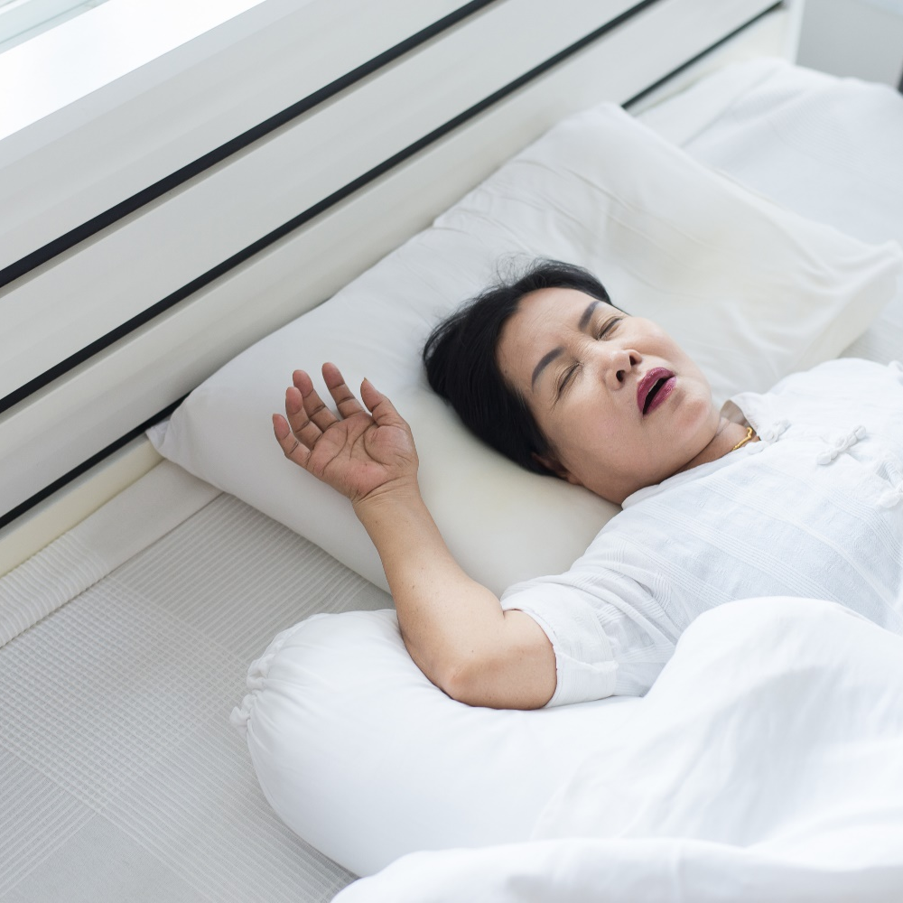
What is OSA?
A common and seriously disruptive and dangerous sleep disorder
Why is it so disruptive and dangerous?
Obstruction of the throat during sleep
causes
The brain and body to become oxygen deprived
Waking up during the night several times a night - even hundreds of times a night in severe cases.
SLEEPEDUCATION.ORG
Notes:
Obstructive sleep apnea is a common and a seriously disruptive and dangerous sleep disorder.
You have repeated episodes of partial or complete obstruction of the throat (also known as the "pharynx" or "upper airway") during sleep.
Your brain and body become oxygen deprived and you may wake up. This may happen a few times a night, or in more severe cases, several hundred times a night.

Slide 3

Prevalence
SLEEPEDUCATION.ORG
One‐seventh of the world's adult population (roughly one billion people!) are estimated to have OSA.¹
OSA is estimated to affect between 2-9% of adults in the United States.²
¹Benjafield AV, Ayas NT, Eastwood PR, Heinzer R, Ip MSM, Morrell MJ, Nunez CM, Patel SR, Penzel T, Pepin JL et al. Estimation of the global prevalence and burden of obstructive sleep apnoea: a literature‐based analysis. Lancet Respir. Med. 2019; 7: 687–98.
²Donovan LM, Kapur VK. Prevalence and Characteristics of Central Compared to Obstructive Sleep Apnea: Analyses from the Sleep Heart Health Study Cohort. Sleep. 2016 Jul 1;39(7):1353-9. doi: 10.5665/sleep.5962. PMID: 27166235; PMCID: PMC4909617.
Notes:
As the rate of obesity is increasing in our country and worldwide, the number of people with OSA has also increased.

Slide 4
Risk Factors
Large Neck Size
Middle Age
Excess Weight
Airway Abnormality
Sedation
Family History
Male
Hypertension
SLEEPEDUCATION.ORG
Notes:
Excess weight – Your risk for sleep apnea is higher if you are overweight (with a body mass index (BMI) of 25 or more) or obese (with a BMI of 30 or higher).
Large neck size - Your risk for sleep apnea is higher if you have a neck size of 17 inches or more for men, or 16 inches or more for women. A large neck has more soft tissue that can block your airway during sleep.
Middle age – Sleep apnea can occur at any age. However, it is more common between young adulthood and middle age.
Male gender – Sleep apnea is more common in men than in women. For women, the risk of sleep apnea increases with menopause.
Race - OSA is also more common in African Americans.
Airway abnormalities - abnormalities such as deviated nasal septum, nasal polyps, enlargement of tonsils and adenoids (seen more in children) and craniofacial abnormalities mostly affecting the jaws can cause narrowing of the airway leading to OSA. Craniofacial abnormalities causing OSA is often seen in Asian patients who are typically non-obese.
Hypertension – High blood pressure is common in people who have sleep apnea.
Family history – This means that you may have a higher risk of sleep apnea if a family member also has it. Inherited traits that increase the risk for sleep apnea include obesity and physical features such as a recessed jaw. Other common family factors - such as physical activity and eating habits - also may play a role.
Sedation - certain medications such as benzodiazepines, narcotics or alcohol use can interfere with the ability to awaken from sleep and can lengthen periods of apnea

Slide 5
Warning Signs
Daytime Symptoms
Nighttime Symptoms
Daytime sleepiness and exhaustion
Trouble concentrating, forgetfulness, mood changes, or crankiness
Decreased sexual desire
High blood pressure
Gastroesophageal reflux disease (GERD)
Snoring, tossing and turning during sleep
Waking up suddenly and feeling like you're gasping or choking
Waking frequently during the night to go to the bathroom
Trouble getting up, followed by headaches in the morning
SLEEPEDUCATION.ORG
AASM.ORG
Notes:
Some people may not have significant symptoms or may not recognize the symptoms. Frequently a sleep partner’s report is what leads to the testing and diagnosis of OSA. Sometimes, in the case of hospitalized patients or patients recovering from surgery or anesthesia, the doctor or nurses see repeated drops in the oxygen during sleep and refer them for testing for OSA.

Slide 6
HEALTH RISKS RELATED TO OSA
Heart Disease
High Blood Pressure
Stroke
Type 2 Diabetes
Depression
Risk of
Death
SLEEPEDUCATION.ORG
AASM.ORG
Notes:
OSA increases the risk for cardiovascular disease - such as hypertension or high blood pressure, coronary artery disease, atrial fibrillation and pulmonary hypertension.
In some patients with heart failure, a different type of sleep apnea called central sleep apnea can occur.
Having untreated OSA is also a risk factor for stroke. Patient affected by stroke have a higher risk of OSA and also central sleep apnea.
In very severe OSA, there is increased risk of sudden cardiac death.
OSA is also seen more frequently in thyroid conditions and in women with polycystic ovarian disease.
Drowsy driving from the OSA causing poor sleep and motor vehicle crashes are seen more often in patients with OSA.

Slide 7
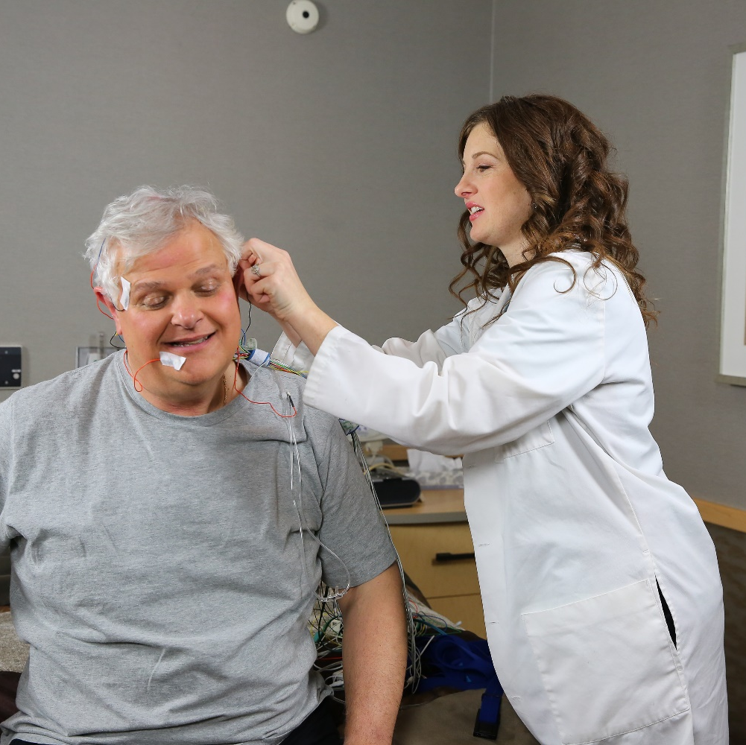
OSA Evaluation
Your doctor will:
Make a judgement based on your signs and symptoms, an exam, and tests.
Will likely refer you to a sleep specialist in a sleep center for further evaluation.
SLEEPEDUCATION.ORG
AASM.ORG
Notes:
A detailed assessment of your symptoms, underlying conditions, and physical examination may help the doctor decide your risk of having OSA.
Some of the doctors will send the patient for nighttime sleep test to a sleep lab while others may refer the patient to a sleep specialist.

Slide 8

Diagnosing OSA
Sleep apnea can be diagnosed by a sleep doctor at an AASM-accredited sleep center.
Diagnosis may require:
Sleep evaluation
Physical exam
Overnight sleep study
Home sleep apnea test
Find an AASM-Accredited Sleep Disorders Center
SLEEPEDUCATION.ORG
AASM.ORG
Notes:
Overnight sleep study
This type of sleep study requires you to stay overnight at a sleep center, in a bed that may resemble a hotel room. You will sleep with sensors hooked up to various parts of your body. These sensors record your brain waves, heartbeat, breathing and movement. Doctors usually recommend a sleep study for more complex cases. A sleep study is the more expensive option, but it is usually covered by most health insurance plans. An overnight sleep study also provides your doctor with the most complete information about your sleep.
Home sleep apnea test
Some patients with high-risk factors for sleep apnea and no other medical disorders may be candidates for a home sleep apnea test. This type of sleep test lets you sleep in the comfort of your own home while a small monitor collects data as you sleep. The testing equipment is less complicated than what is used in an overnight sleep study. Sleep center staff will show you how to hook up the testing equipment yourself. After your home sleep apnea test, you can take the device back to the sleep center or send it by mail.
Data interpretation: After your sleep study or home sleep apnea test, you will schedule a follow-up appointment to discuss the results. If you are diagnosed with sleep apnea, your doctor will discuss your treatment options with you.

Slide 9

Treating OSA
Treating sleep apnea restores healthy sleep, improves quality of life and decreases health risks.
Lifestyle changes
Weight loss
CPAP therapy
Positional therapy
Oral appliance therapy
Surgery
Cognitive behavioral therapy
SLEEPEDUCATION.ORG
AASM.ORG
Notes:
Weight management- In some cases weight loss can help improve or eliminate your sleep apnea symptoms if you are overweight or obese. Overweight people often have thick neck with extra tissue in the throat that may block the airway. There is no guarantee that losing weight will eliminate your sleep apnea, although it may help.
CPAP (continuous positive airway pressure)-CPAP is a machine that uses a steady stream of air to gently keep your airway open throughout the night, so you are able to breathe. You sleep with a mask with a hose that is attached to a machine kept at the bedside. Masks and machines may vary depending on your treatment and comfort needs. CPAP is the frontline treatment for sleep apnea and is usually recommended for most patients.
Positional therapy-Positional therapy is a behavioral strategy to treat positional sleep apnea. Some people have sleep apnea primarily when sleeping on their back. This is called the “supine” position. Their breathing returns to normal when they sleep on their side. Positional therapy may involve wearing a special device around your waist or back. It keeps you sleeping in the side position. Another option is a small device that uses “vibro-tactile feedback” technology. Worn on the back of the neck, it gently vibrates when you start to sleep on your back. Without waking you up, the vibration alerts your body to change positions. Positional therapy can be used alone or together with another sleep apnea treatment.
Oral appliance therapy- An oral appliance is a device that fits in your mouth over your teeth while you sleep. It may resemble a sports mouth guard or an orthodontic retainer. The device prevents the airway from collapsing by holding the tongue in position or by sliding your jaw forward so that you can breathe when you are asleep. Some patients prefer sleeping with an oral appliance over a CPAP machine. A dentist trained in dental sleep medicine can fit you with an oral appliance after you are diagnosed with sleep apnea. Oral appliance therapy is recommended for patients with mild to moderate sleep apnea who cannot tolerate CPAP or simply prefer to try the oral appliance instead of a CPAP device.
Surgery- There are a variety of surgical options you can elect to have if CPAP or oral appliance therapy does not work for you. The most common options reduce or eliminate the extra tissue in your throat that collapses and blocks your airway during sleep. More complex procedures can adjust your bone structures including the jaw, nose and facial bones. A newer option where an implantable device causes the muscles of the tongue to contract and lead to a more open airway may have a role in selected patients who fail CPAP therapy or decline it. Weight loss surgery may also be an option.

